Slide 2
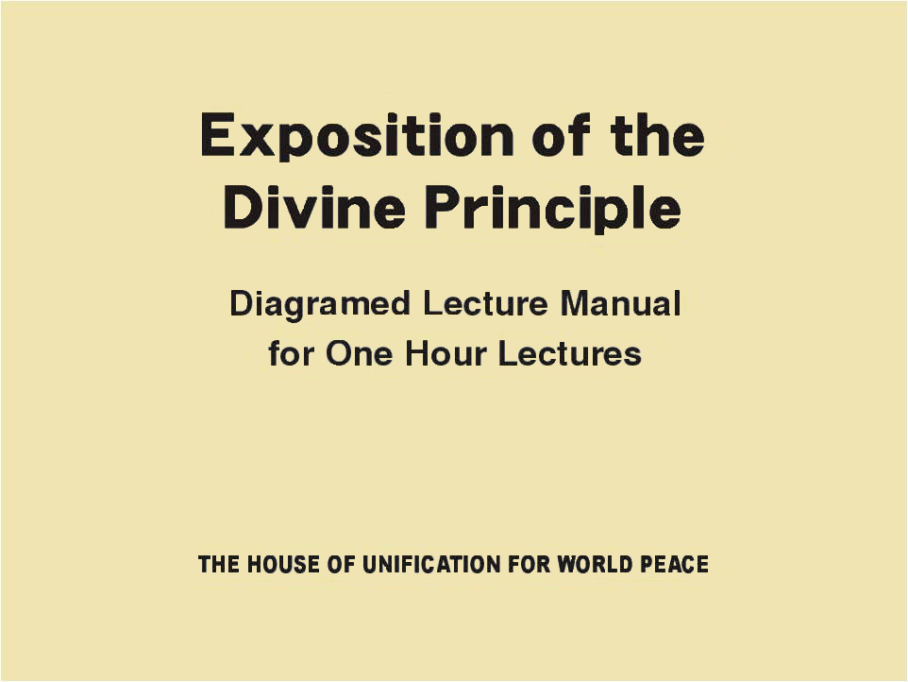
Part One

Slide 3
Father Moon’s Prayer
Guide us to be true children of Your hope
Offering You all our hearts that long for You, we repent our past, critically reflect on our present, and long for our true self of tomorrow. Father, give us a proof that we are Your sons and daughters.
Make us the children You have been hoping and searching for. Make us the people who can represent the value of the entire universe and the value of the center, so that You can call us Your sons and daughters with all Your feelings, and senses. We are hoping that although we are of little value, You can still feel Your children through us.
Notes:
Father Moon’s Prayer

Slide 4
Father Moon’s Prayer
Father, You always love us with gentle love, and have been working hard to pioneer the foundation of our life. Father, we are thankful for your having endured the long years with a hope to meet true sons and daughters of Yours. As our hearts originate only from You, we follow your heart and long for true sons and daughters who can possess a value in the world of Your desire.
We have come here in order to be the children who can be called by the holy, merciful, and revered Father. With Your gentle lead and admonition, guide us to be children with a firm determination for the hope and mission of tomorrow. We pray all this in the holy name of the True Parents. Amen. (12.13.1970)
(Prayers of Rev. Sun Myung Moon)
Notes:
Father, You always love us with gentle love, …

Slide 5
From True Parents’ Life Course
At sixteen, I had a mysterious experience. In the morning of Easter, after I made a long tearful prayer, Jesus Christ appeared to me and gave me many revelations and teachings. He told me much about deep and amazing things. He said that God is grieved because of the suffering humanity.
And he asked me to undertake a special role on earth for the sake of God’s work. In short, the spiritual world suddenly opened up before me and I could freely communicate with the saints there.
In the quietude of a deep North Korean mountain, I talked with Jesus Christ several times. The truth revealed at that time forms the core of the Unification Principle. That was the beginning of the revelation.
Notes:
From True Parents’ Life Course
At sixteen, I had a mysterious experience……..

Slide 6
From True Parents’ Life Course
Ever since that special meeting, I have been conversing with the saints of the spiritual world including the living God and Jesus. Little by little, God taught me the amazing truth. It was as if the morning sun was rising after a long and dark night. In this truth, I could see the dawn of the glorious new culture. This special revelation, based on the New Testament, has the power to bring all the religions together. Today this revelation is called the Divine Principle, and I have received an order from God to spread the Divine Principle to the ends of the earth.
Notes:
Ever since that special meeting, …

Slide 7
Main Branches of the
Divine Principle
Principle of Creation
Human Fall
Restoration (salvation)
Second Advent
This is the content of a one-hour manual, which presents just the core contents of the Principle. There are other presentations with more detailed content.
Notes:
This is the content of a one-hour manual, which presents just the core contents of the Principle. There are other presentations with more detailed content

Slide 8
Introduction
Notes:
Introduction

Slide 9

Happiness
Misfortune
Desires
•
Everyone is struggling to attain happiness and avoid misfortune.
•
People feel joy when their desires are fulfilled.
Notes:
EVERYONE is struggling to attain HAPPINESS and avoid MISFORTUNE.
People feel joy when their DESIRES are fulfilled

Slide 10

Goodness
Original
Mind
Evil
Mind
Wickedness
"None is righteous, no, not one;”
Happiness
Misfortune
Romans 3:10
Desires
•
Within the self-same individual are two opposing desires: the original mind which desires goodness and the evil mind which desires wickedness.
Notes:
Within the self-same individual are two opposing desires: the ORIGINAL mind which desires GOODNESS and the EVIL mind which desires WICKEDNESS.

Slide 11
[22] For I delight in the law of God, in my inmost self,
[23] but I see in my members another law at war with the law of my mind and making me captive to the law of sin which dwells in my members.
[24] Wretched man that I am! …
Goodness
Original
Mind
Evil
Mind
Wickedness
contradiction
Romans 7:22-24
Desires
•
Any being possessing such a contradiction within itself is doomed to perish.
Notes:
Any being possessing such a CONTRADICTION within itself is doomed to perish

Slide 12
Goodness
Original
Mind
Evil
Mind
Wickedness
contradiction
Desires
state of destruction
...…
the Fall
•
Christianity sees this state of destruction as the result of the human Fall.
Notes:
Christianity sees this STATE of destruction as the result of the HUMAN fall.

Slide 13





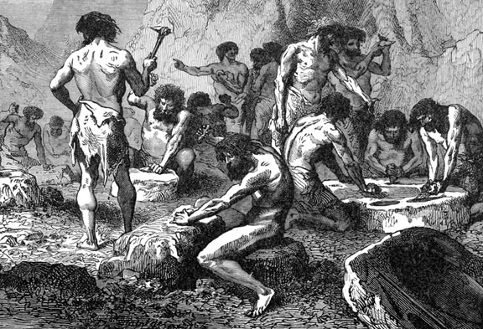
Human Ignorance
Intellect
Ignorance
•
Considered from the viewpoint of the intellect, the human Fall represents humanity’s descent into ignorance.
Notes:
Considered from the viewpoint of the intellect, the human Fall represents HUMANITY’S descent into IGNORANCE.
______________
Stone Age blacksmiths using fire to make tools _ ca 72,000 years ago

Slide 14
Human Ignorance
mind
Intellect
Ignorance
body
•
People are composed of two aspects: internal and external, or mind and body;
Notes:
People are composed of two aspects: internal and external, or MIND and BODY;

Slide 15
Human Ignorance
mind
Internal
Ignorance
body
External
Ignorance
•
In the same way, there are two types of ignorance:
internal ignorance and external ignorance.
Notes:
In the same way, there are two types of ignorance: INTERNAL ignorance and EXTERNAL ignorance.

Slide 16
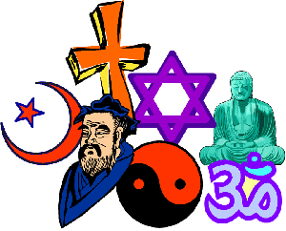
Human Ignorance
mind
Internal
Ignorance
Internal
truth
Internal
Ignorance
Religion
body
External
Ignorance
External
Ignorance
•
Humanity through religion has followed the path of searching for internal truth.
Notes:
Humanity through RELIGION has followed the path of searching for INTERNAL truth.
And through SCIENCE has followed the path of seeking EXTERNAL truth.

Slide 17
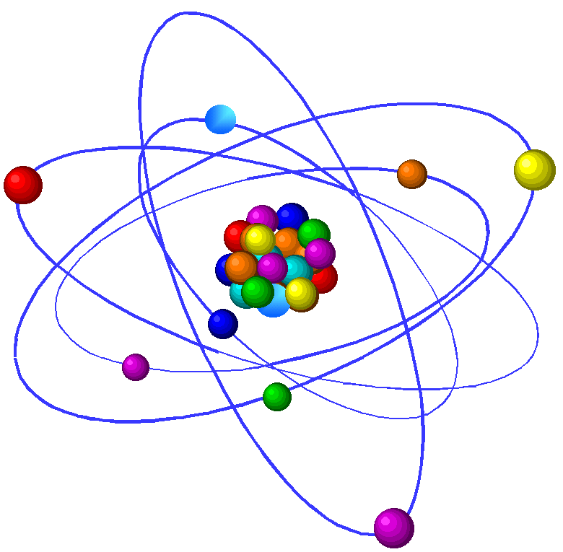
Internal
Ignorance
Internal
truth
Religion
Science
External
Ignorance
External
truth
•
And through science has followed the path of seeking external truth.
Notes:
Humanity through RELIGION has followed the path of searching for INTERNAL truth.
And through SCIENCE has followed the path of seeking EXTERNAL truth.

Slide 18
Internal
Ignorance
Internal
truth
Religion
Science
External
Ignorance
External
truth
•
Religion and Science have seemed, in the course of their development, to take positions that were contradictory and irreconcilable.
Notes:
Religion and Science have seemed, in the course of their development, to take positions that were contradictory and irreconcilable.

Slide 19
Internal
Ignorance
Internal
truth
Religion
25 “I have said this to you in figures; the hour is coming when I shall no longer speak to you in figures but tell you plainly of the Father.
Realize
Good-
ness
New Truth
Science
External
Ignorance
External
truth
John 16:25
•
However, for humankind to completely overcome the two aspects of ignorance and fully realize the goodness which the original mind desires, at some point in history there must emerge a new truth which can reconcile religion and science and resolve their problems in an integrated undertaking.
Notes:
However, for humankind to completely overcome the two aspects of ignorance and fully REALIZE the goodness which the original mind desires, at some point in history there must emerge a NEW truth which can reconcile RELIGION and SCIENCE and resolve their problems in an integrated undertaking.

Slide 20
Internal
Ignorance
Internal
truth
36 He told them a parable also: “No one tears a piece from a new garment and puts it upon an old garment; ….
37 And no one puts new wine into old wineskins; ….
38 But new wine must be put into fresh wineskins.”
Religion
Realize
Good-
ness
New Truth
Science
External
Ignorance
External
truth
Luke 5:36-38
•
However, for humankind to completely overcome the two aspects of ignorance and fully realize the goodness which the original mind desires, at some point in history there must emerge a new truth which can reconcile religion and science and resolve their problems in an integrated undertaking.
Notes:
However, for humankind to completely overcome the two aspects of ignorance and fully REALIZE the goodness which the original mind desires, at some point in history there must emerge a NEW truth which can reconcile RELIGION and SCIENCE and resolve their problems in an integrated undertaking.

Slide 21



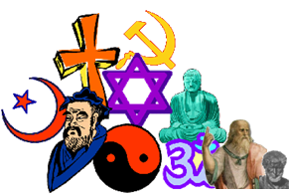

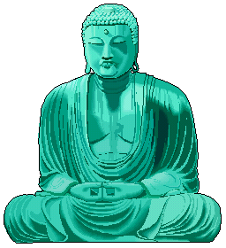

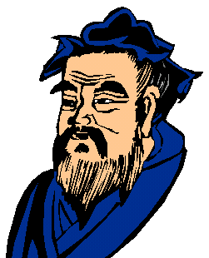
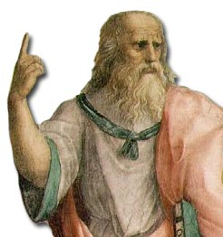


Mission of the new truth
Religions
Ideologies
Philosophies
Religions
Ideologies
Philosophies
Unity
•
New Truth should be able to embrace all historical religions, ideologies, and philosophies and bring complete unity among them.
Notes:
New Truth should be able to embrace all historical RELIGIONS, ideologies, and philosophies and bring complete UNITY among them.

Slide 22

Mission of the new truth
Religions
Ideologies
Philosophies
Religions
Ideologies
Philosophies
Unity
Unity
Fallen
people
Original
state
•
New Truth should guide fallen people to return to their original state.
Notes:
New Truth should guide FALLEN people to return to their ORIGINAL state.

Slide 23
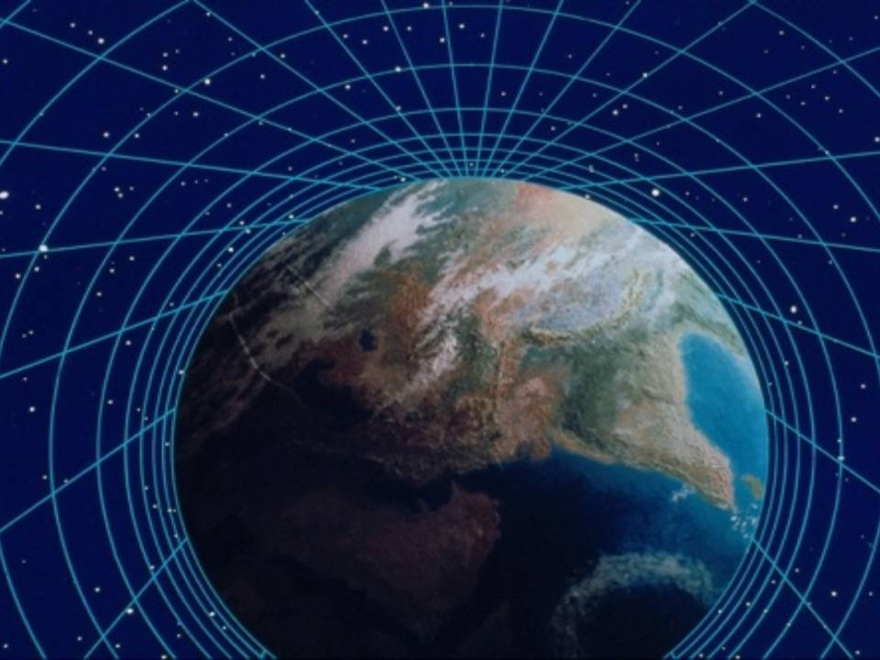
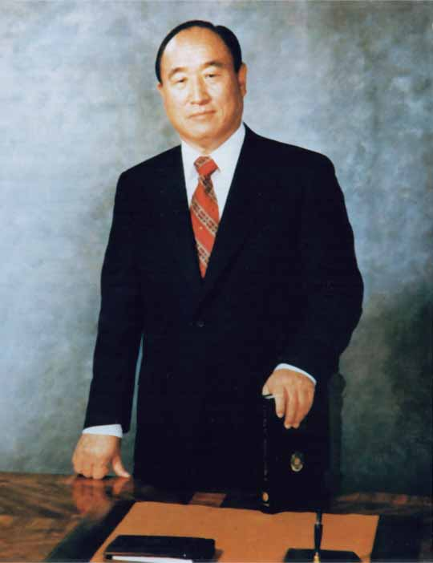
Mission of the new truth
Religions
Ideologies
Philosophies
Religions
Ideologies
Philosophies
Unity
Fallen
people
Original
state
Reverend
Sun Myung Moon
•
God has sent Rev. Sun Myung Moon to this earth to resolve the fundamental problems of human life and the universe.
Notes:
God has sent one person to this earth to resolve the fundamental problems of human life and the universe. His name is REV. SUN MYUNG MOON.

Slide 24
Key Points
We need Science & Religion for happiness
We need an expression of truth that harmonizes them
Notes:
Key Points

Slide 26
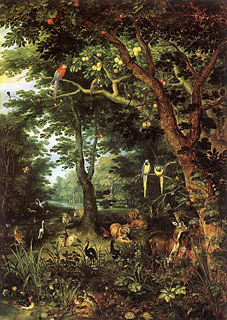
Chapter 1
The Principle of Creation
Notes:
Chapter 1
The Principle of Creation

Slide 27
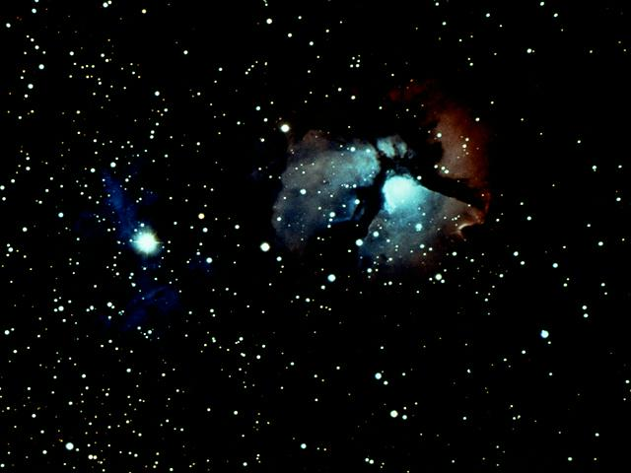
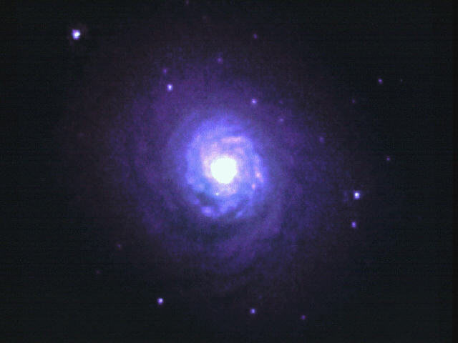
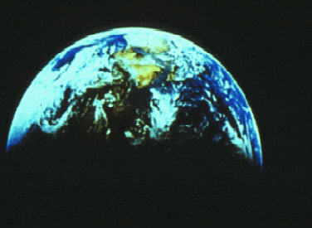
Chapter 1
The Principle of Creation
Causal
reality
Humanity
and
Universe
Humanity
and
Universe
God
•
Problems concerning human life and the universe cannot be solved without first understanding the nature of God.
Notes:
Problems concerning HUMAN life and the universe cannot be solved without first understanding the nature of GOD.

Slide 28
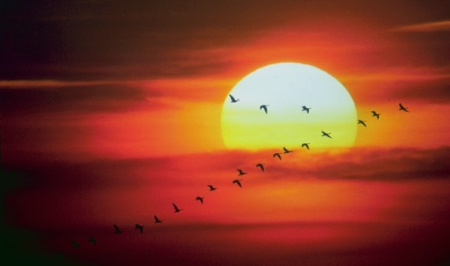
The nature of God
•
One way to fathom God’s deity is by observing the universe which He created.
Notes:
One way to fathom God’s deity is by observing the universe which He created.

Slide 29
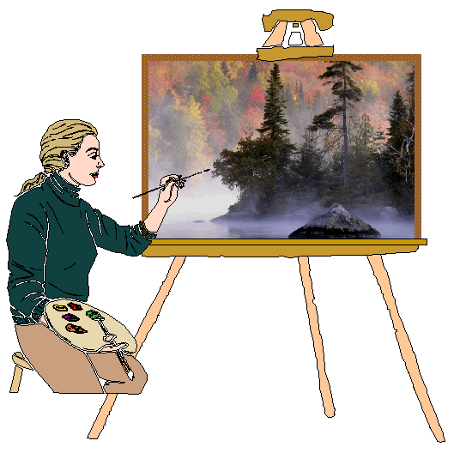
The nature of God
Character of
an artist
Nature of
God
Invisible:
Ever since the creation of the world his invisible nature, namely, his eternal power and deity, has been clearly perceived in the things that have been made. So they are without excuse.
Rom.
1:20
Works of Art
Creation
Visible:
Romans 1:20
•
Just as we can come to know the character of an artist through his works, so we can understand the nature of God by observing the diverse things of creation (Rom. 1:20).
Notes:
Just as we can come to know the CHARACTER of an artist through his WORKS, so we can understand the NATURE of God by observing the diverse things of CREATION (Rom. 1:20).

Slide 30
Common elements found universally throughout the natural world
Common elements
•
Let us begin to point out the common elements which are found universally throughout the natural world.
Notes:
Let us begin to point out the COMMON elements which are found universally throughout the natural world.

Slide 31
Common elements found universally throughout the natural world
Entity
Yang
Dual
Characteristics
1
]
Yin
1
Every entity, both within the entity and between it and other entities, possesses dual characteristics of yang and yin.
Notes:
1. Every ENTITY, both within the entity and between it and other entities, possesses DUAL characteristics of YANG and YIN.

Slide 32
Common elements found universally throughout the natural world
Entity
Yang
Dual
Characteristics
1
]
Yin
(inner quality)
Entity
2
(outer form)
2
More fundamentally, every entity possesses both an outer form and inner quality. The visible outer form resembles the invisible inner quality.
Notes:
2. More fundamentally, every entity possesses both an OUTER form and INNER quality. The visible outer form resembles the invisible inner quality.

Slide 33
Common elements found universally throughout the natural world
Entity
Yang
Dual
Characteristics
1
]
Yin
(inner quality)
Internal nature
Entity
]
Dual
Characteristics
2
(outer form)
External form
The inner quality is called internal nature, and the outer form or shape is called external form. The internal nature and external form together constitute dual characteristics.
Notes:
The inner quality is called INTERNAL nature, and the outer form or shape is called EXTERNAL form. The internal nature and external form together constitute DUAL characteristics.

Slide 34
God’s dual characteristics
internal nature
]
Dual
Characteristics
First
Cause
external form
•
The First Cause of all things must also possess the dual characteristics of internal nature and external form, which stand in the position of subject partner to the internal natures and external forms of all beings.
Notes:
The FIRST Cause of all things must also possess the dual characteristics of internal nature and external form, which stand in the position of subject partner to the internal natures and external forms of all beings.

Slide 35
God’s dual characteristics
internal nature
Original
God
Dual
Characteristics
First
Cause
]
external form
Original
We call this First Cause God, and His internal nature and external form the original internal nature and original external form.
Notes:
We call this First Cause GOD, and His internal nature and external form the ORIGINAL internal nature and ORIGINAL external form.

Slide 36
God’s dual characteristics
God
(Original) Yang
Dual
Characteristics
First
Cause
]
(Original) Yin
internal nature
Original
God
Dual
Characteristics
First
Cause
]
external form
Original
•
God also exists based on the reciprocal relationship between His dual characteristics of yang and yin.
Notes:
God also exists based on the reciprocal relationship between His DUAL characteristics of YANG and YIN.

Slide 37
God is:
●
The Subject in whom the dual characteristics
of original internal nature
and original
external form are in harmony.
•
The Subject in whom the dual characteristics of original internal nature and original external form are in harmony.
Notes:
SUBJECT partner of internal nature and masculinity towards the universe

Slide 38
God is:
●
The Subject in whom the dual characteristics
of original internal nature
and original
external form are in harmony.
●
At the same time, God is the harmonious union of masculinity and femininity, which manifest the qualities of original internal nature and original external form, respectively.
•
At the same time, God is the harmonious union of masculinity and femininity, which manifest the qualities of original internal nature and original external form, respectively.
Notes:
SUBJECT partner of internal nature and masculinity towards the universe

Slide 39
God is:
●
The Subject in whom the dual characteristics
of original internal nature
and original
external form are in harmony.
●
At the same time, God is the harmonious union of masculinity and femininity, which manifest the qualities of original internal nature and original external form, respectively.
●
In relation to the universe, God is the subject partner having the qualities of internal nature and masculinity.
•
In relation to the universe, God is the subject partner having the qualities of internal nature and masculinity.
Notes:
SUBJECT partner of internal nature and masculinity towards the universe

Slide 40
God is:
●
The Subject in whom the dual characteristics
of original internal nature
and original
external form are in harmony.
●
At the same time, God is the harmonious union of masculinity and femininity, which manifest the qualities of original internal nature and original external form, respectively.
●
In relation to the universe, God is the subject partner having the qualities of internal nature and masculinity.
●
In recognition of God’s position as the internal and masculine subject partner, we call Him “Our Father”.
•
In recognition of God’s position as the internal and
masculine subject partner, we call Him “Our Father”.
Notes:
SUBJECT partner of internal nature and masculinity towards the universe

Slide 41
The relationship between God and the universe
Universe
God
Internal
nature
+
+
-
Human
beings
Original
internal
nature
-
External
form
+
-
Internal
nature
+
Original
external
form
+
-
-
All
things
External
form
+
Invisible
subject
partner
-
Substantial object partner
•
God is the invisible subject partner, and the universe as a whole is a substantial object partner to God.
Notes:
GOD is the INVISIBLE subject partner, and the UNIVERSE as a whole is a SUBSTANTIAL object partner to God.

Slide 42
The relationship between God and the universe
Universe
God
Internal
nature
+
+
-
Human
beings
Original
internal
nature
Image
-
Principle
of
Creation
+
External
form
-
Internal
nature
+
Original
external
form
+
-
Symbol
All
things
-
External
form
+
Invisible
subject
partner
-
Substantial object partner
In accordance with the Principle of Creation, God’s dual characteristics manifest itself symbolically or in image as individual embodiments of truth, which constitute the universe.
Notes:
In accordance with the PRINCIPLE of creation, God’s dual characteristics manifest itself SYMBOLICALLY or in IMAGE as individual embodiments of truth, which constitute the universe.

Slide 43
Universal Prime Energy
God
Fundamental
energy
•
Creator
•
Universal
Prime
Energy
Eternal
Absolute reality
•
Eternal
Self-existent
•
Self-existent
Absolute
•
Transcendent
•
God, the Creator of all things, is the absolute reality, eternal, self-existent and transcendent of time and space. Universal prime energy is the fundamental energy of God’s being.
Notes:
GOD, the CREATOR of all things, is the ABSOLUTE reality, eternal, self-existent and transcendent of time and space. UNIVERSAL prime energy is the fundamental energy of GOD’S being.

Slide 44
Universal Prime Energy
God
Fundamental
energy
•
Creator
•
Universal
Prime
Energy
Eternal
Absolute reality
•
Eternal
Self-existent
•
Self-existent
Absolute
•
Transcendent
Created
beings
Origin of
all energy
Exist
•
It is the origin of all energies and forces that allow created beings to exist.
Notes:
It is the origin of all energies and forces that allow CREATED beings to EXIST.

Slide 45
Give and take action
God
(U. P. E.)
Subject
element
Object
element
•
Through the agency of universal prime energy, the subject and object elements of every entity form a common base and enter into interaction.
Notes:
Through the agency of UNIVERSAL prime energy, the subject and OBJECT elements of every entity form a common base and enter into INTERACTION.

Slide 46
Give and take action
God
(U. P. E.)
Subject
element
Object
element
}
Exist
Forces
………..
Multiply
Act
This interaction, in turn, generates all the forces the entity needs for existence, multiplication and action.
Notes:
This interaction, in turn, generates all the FORCES the entity needs for EXISTENCE, multiplication and action.

Slide 47
Give and take action
God
(U. P. E.)
Subject
element
Object
element
}
Exist
Forces
Forces
………..
Multiply
Act
•
The interaction generating these forces through this process is called give and take action.
Notes:
The interaction generating these forces through this process is called give and take action.

Slide 48
Origin-division-union-action
_ _ _ _ _ _ _ _ _
Origin
God
Subject
partner
Object
partner
_ _ _
Division
Union
_ _ _ _ _ _ _ _ _
Union
•
The process in which out of God, the Origin, two entities are separately manifested and reunited in oneness is called origin – division – union action.
Notes:
The process in which out of GOD, the Origin, two ENTITIES are separately manifested and REUNITED in oneness is called ORIGIN–DIVISION–UNION action.

Slide 49
Three object purpose
(Origin)
God
Subject
Partner
Object
Partner
Union
•
As a result of origin-division-union action, four positions are formed: the origin (God) at the center, the subject partner and the object partner, and their union.
Notes:
As a result of origin-division-union action, four positions are formed: the ORIGIN (God) at the center, the SUBJECT partner and the OBJECT partner, and their UNION.

Slide 50
Three object purpose
(Origin)
Subject
Partner
Object
Partner
God
Union
Subject
Partner
Object
Partner
Union
God
God
Union
Object
Partner
Subject
Partner
Union
Object
Partner
Subject
Partner
God
Communion of
three Object Partners
Any one of the four positions may assume the position of subject partner and engage the other three as its object partners, forming a communion of three object partners.
Notes:
Any one of the four positions may ASSUME the position of subject partner and engage the other three as its object partners, forming a COMMUNION of three object partners.

Slide 51
Three object purpose
(Origin)
Subject
Partner
Object
Partner
God
Union
Subject
Partner
Object
Partner
Union
God
God
Union
Object
Partner
Subject
Partner
Union
Object
Partner
Subject
Partner
God
Communion of
three Object Partners
Give and take action
Three object purpose
•
When each of the four then acts as the subject partner and enters into give and take with the other three revolving around it, they fulfill the three object purpose.
Notes:
When each of the four then acts as the subject partner and enters into GIVE and take with the other three revolving around it, they fulfill the THREE object purpose.

Slide 52
The Four Position Foundation
Origin
_ _ _ _ _
God
Divi-
sion
_ _
Subject
partner
Object
partner
Union
_ _ _ _ _
Union
•
When the origin(God), the subject partner and object partner projected from the origin, and their union all engage in a harmonious give and take action and fulfill the three object purpose, the four position foundation is established.
Notes:
When the ORIGIN (God), the SUBJECT partner and OBJECT partner projected from the origin, and their UNION all engage in a harmonious give and take action and fulfill the three object purpose, the four position foundation is established.

Slide 53
The Four Position Foundation
Origin
_ _ _ _ _
God
Divi-
sion
_ _
Subject
partner
Object
partner
Union
_ _ _ _ _
Union
Eternal purpose of creation
•
The four position foundation is the fundamental foundation of goodness and the realization of God’s eternal purpose of creation.
Notes:
The four position foundation is the fundamental foundation of goodness and the realization of God’s ETERNAL purpose of creation.

Slide 54




The Purpose of Creation
And God blessed them, and God said to them, "Be fruitful and multiply, and fill the earth and subdue it; and have dominion over the fish of the sea and over the birds of the air and over every living thing that moves upon the earth."
God
Three
blessings
Creations
Gen. 1:28
Four position
foundation
Gen. 1:28
•
The three great blessings (Gen. 1:28) are fulfilled when the whole creation, including human beings, completes the four position foundation with God as the center.
Notes:
The THREE great blessings (Gen. 1:28) are fulfilled when the whole CREATION, including human beings, completes the four position foundation with GOD as the center.

Slide 55
The Purpose of Creation
God
Three
blessings
Joy
Creations
Gen. 1:28
Four position
foundation
This is the Kingdom of Heaven, where ultimate goodness is realized and God feels the greatest joy. This is, in fact, the very purpose for which God created the universe.
Notes:
The THREE great blessings (Gen. 1:28) are fulfilled when the whole CREATION, including human beings, completes the four position foundation with GOD as the center.

Slide 56
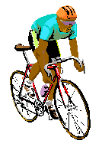



God’s three blessings
First blessing
Individual perfection
God
Mind
Body
Mind
Body
One
Indi-
vidual
Individual FPF
•
God’s first blessing is to perfect our individual character; for this, an individuals mind and body should become one (person) through give and take action, thereby forming a God-centered individual four position foundation.
Notes:
God’s FIRST blessing is to perfect our INDIVIDUAL character; for this, an individuals MIND and BODY should become ONE (person) through give and take action, thereby forming a God-centered INDIVIDUAL four position foundation.

Slide 57
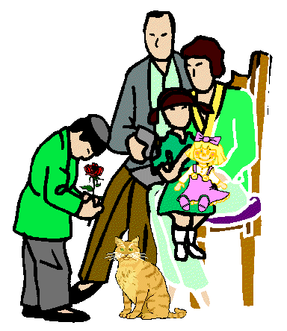
God’s three blessings
First blessing
Second blessing
Individual perfection
Family perfection
God
God
Hus-
band
Wife
Hus-
band
Mind
Body
Wife
Indi-
vidual
Children
Children
Individual FPF
Family FPF
•
In fulfilling God’s second blessing, an individually perfected man and woman should join in loving oneness as husband and wife and raising children,
thereby constructing a God-centered family four position foundation.
Notes:
In fulfilling God’s SECOND blessing, an individually perfected man and woman should join in loving oneness as HUSBAND and WIFE and raising CHILDREN, thereby constructing a God-centered FAMILY four position foundation.

Slide 58


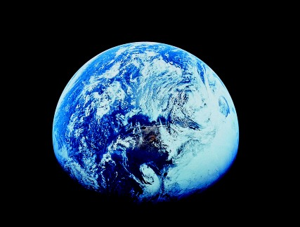
God’s three blessings
First blessing
Second blessing
Third blessing
Third blessing
Individual perfection
Family perfection
Perfection of dominion
Perfection of dominion
God
God
God
God
Hus-
band
Human
Beings
Natural
World
Human
beings
Human
beings
Natural
world
Mind
Body
Wife
Natural
world
One
Indi-
vidual
Children
Creation
Creation
Individual FPF
Family FPF
FPF of dominion
•
God’s third blessing is to perfect human dominion over the natural world; for this, human beings and the natural world should become completely one (universe), thereby establishing a God-centered four position foundation of dominion.
Notes:
God’s THIRD blessing is to perfect HUMAN dominion over the natural world; for this, HUMAN beings and the NATURAL world should become completely ONE (universe), thereby establishing a God-centered FOUR position foundation of dominion.

Slide 59
The process of the creation of the universe
6 days
Six periods in the
creation process
------
(Gen. 1)
•
The biblical period of six days for the completion of the universe in Genesis 1 is not to be reckoned by the number of literal sunrises and sunsets. It symbolizes six ordered periods of time in the creation process.
Notes:
The biblical period of SIX days for the completion of the universe in Genesis 1 is not to be reckoned by the number of literal sunrises and sunsets.
It symbolizes SIX ordered periods of time in the creation process.

Slide 60
The process of the creation of the universe
God
Time
6 days
Six periods in the
creation process
------
(Gen. 1)
Universe
•
The fact that it took six time periods to complete the creation of the universe implies that some period of time was also necessary to complete the creation of each of the individual entities that make up the universe.
Notes:
The fact that it took six time periods to complete the creation of the universe implies that some period of time was also necessary to complete the creation of each of the individual entities that make up the universe.

Slide 61
The growing period for the creation
_______________________________________
Completion
---------------------------------------------------------------------
Growth
------------------------------------------------
---------------------
Formation
_______________________________________
•
All creation reaches perfection by passing through three ordered stages of growth: the formation stage, the growth stage and completion stage.
Notes:
All creation reaches perfection by passing through three ordered stages of growth: the FORMATION stage, the GROWTH stage and COMPLETION stage.

Slide 62
The growing period for the creation
_______________________________________
Growing period
Completion
---------------------------------------------------------------------
Growth
------------------------------------------------
---------------------
Formation
_______________________________________
•
When created beings are in the growing period, God has regard only for the fruits of their growth which are based
on the Principle. In this way, He governs all things indirectly.
Notes:
When created beings are in the GROWING period, God has regard only for the fruits of their growth which are based on the Principle. In this way, He governs all things indirectly.

Slide 63
The growing period for the creation
_______________________________________
Growing period
}
Completion
Indirect
dominion
---------------------------------------------------------------------
Growth
------------------------------------------------
---------------------
Dominion
based on
accomplish-
ments
Formation
_______________________________________
We call this growing period the realm of God’s indirect dominion or the realm of dominion based on accomplishments through the Principle.
Notes:
We call this growing period the realm of God’s INDIRECT dominion or the realm of DOMINION based on accomplishments through the Principle.

Slide 64
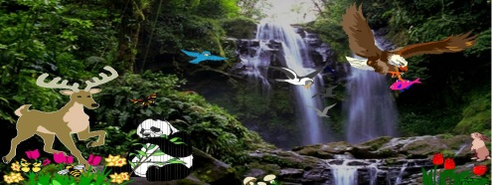
The growing period for the creation
Perfection
_______________________________________
Growing period
}
Completion
Indirect
dominion
---------------------------------------------------------------------
Growth
Principle
------------------------------------------------
---------------------
Dominion
based on
accomplish-
ments
Formation
_______________________________________
All things
All things
•
All things reach perfection after passing through the growing period by virtue of the autonomy and governance given by God’s Principle.
Notes:
ALL things reach PERFECTION after passing through the growing period by virtue of the autonomy and governance given by God’s PRINCIPLE.

Slide 65

The growing period for the creation
Perfection
Perfection
_______________________________________
Growing period
}
Completion
Principle
+
Indirect
dominion
---------------------------------------------------------------------
Growth
Principle
------------------------------------------------
Human
responsibility
---------------------
Dominion
based on
accomplish-
ments
Formation
_______________________________________
All things
All things
Human
beings
•
Human beings, however, pass through the growing period and reach perfection by fulfilling their own portion of responsibility, in addition to the guidance provided by the Principle.
Notes:
HUMAN beings, however, pass through the growing period and reach PERFECTION by fulfilling their own portion of RESPONSIBILITY, in addition to the guidance provided by the Principle.

Slide 66
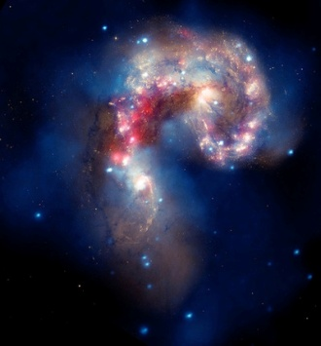
The incorporeal world and the corporeal world
God
Universe
Dual
characteristics
•
The universe was created after the pattern of a human being, who is in the image of God’s dual characteristics.
Notes:
The UNIVERSE was created after the pattern of a HUMAN being, who is in the image of GOD’S dual characteristics.

Slide 67
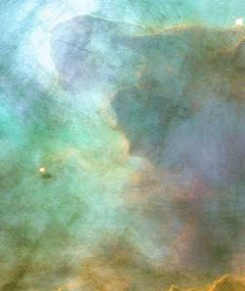
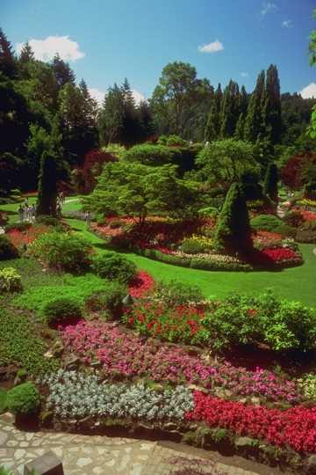
The incorporeal world and the corporeal world
In-
corporeal
world
God
Mind
Cosmos
}
Universe
Body
Corporeal
world
Dual
characteristics
•
Hence, corresponding to the human mind and body, the universe consists of the incorporeal world and the corporeal world, both of which are real and substantial. The two worlds together form the cosmos.
Notes:
Hence, corresponding to the human MIND and BODY, the universe consists of the INCORPOREAL world and the CORPOREAL world, both of which are real and substantial. The two worlds together form the COSMOS.

Slide 68
The incorporeal world and the corporeal world
In-
corporeal
world
God
Mind
Cosmos
}
Universe
Body
Corporeal
world
Dual
characteristics
•
When we shed our physical bodies, we enter the incorporeal world as spirits and live there for eternity.
Notes:
When we shed our physical bodies, we enter the INCORPOREAL world as spirits and live there for eternity.

Slide 69
Key Points
God’s purpose for creating was joy
We bring joy to God through accomplishing the 3 Great Blessings
  To be fruitful
  To multiply
  To have dominion
We grow in the physical world and live eternally in the spiritual world
Notes:
Key Points

Slide 71
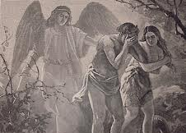
Chapter 2
The Human Fall
Notes:
Chapter 2
The Human Fall

Slide 72
Root of sin
?
•
No one has known the root of sin.
Notes:
No one has known the ROOT of sin.

Slide 73


Root of sin
?
Christians
.…
The fruit
Eating
•
Christians, on the basis of the Bible, have held the vague belief that Adam and Eve’s eating the fruit of the tree of the knowledge of good and evil was the root of sin.
Notes:
CHRISTIANS, on the basis of the BIBLE, have held the vague belief that Adam and Eve’s EATING the fruit of the tree of the knowledge of good and evil was the root of sin.

Slide 74
Root of sin
?
Christians
Fruit of
an actual tree
.…
The fruit
Eating
•
Many Christians have thought that the fruit was that of an actual tree.
Notes:
Many Christians have thought that the fruit was that of an ACTUAL tree.

Slide 75
Root of sin
?
Christians
Fruit of
an actual tree
.…
The fruit
?
Symbols and metaphors
Eating
•
Many important parts of the Bible are expressed in symbols and metaphors; then, what does the fruit of the tree of the knowledge of good and evil represent?
Notes:
Many important parts of the Bible are expressed in SYMBOLS and metaphors; then, WHAT does the fruit of the tree of the knowledge of good and evil represent?

Slide 76
Root of sin
?
Christians
And out of the ground the Lord God made to grow every tree that is pleasant to the sight and good for food, the tree of life also in the midst of the garden, and the tree of the knowledge of good and evil.
Fruit of
an actual tree
.…
The fruit
?
RSV (Genesis 2:9)
Symbols and metaphors
Eating
•
To learn this, let us first investigate the tree of life, which stood next to the tree of the knowledge of good and evil (Gen. 2:9).
Notes:
To learn this, let us first investigate the tree of life, which stood next to the tree of the knowledge of good and evil (Gen. 2:9).

Slide 77


The tree of life and the tree of the knowledge of good and evil
Ideal man
=
Symbolizes
Tree of Life
Perfected Adam
•
The tree of life symbolizes an ideal man who has fully realized the ideal of creation. It thus symbolizes perfected Adam.
Notes:
The TREE of life symbolizes an IDEAL man who has fully realized the ideal of creation. It thus symbolizes PERFECTED Adam.

Slide 78


The tree of life and the tree of the knowledge of good and evil
Ideal woman
=
Symbolizes
Tree of Knowledge
of Good and Evil
Perfected Eve
•
The tree of the knowledge of good and evil represents the ideal woman, perfected Eve.
Notes:
The TREE of the knowledge of good and evil represents the IDEAL woman, PERFECTED Eve.

Slide 79
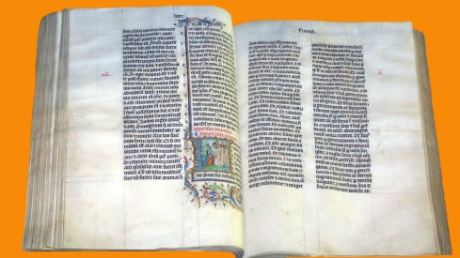
The Identity of the Serpent
But the serpent said to the woman, “You will not die. For God knows that when you eat of it your eyes will be opened, and you will be like God, knowing good and evil.”
RSV (Genesis 3:4-5)
Gen. 3:4-5
•
In the Bible we read that a serpent tempted Eve to commit sin (Gen. 3:4-5).
Notes:
In the BIBLE we read that a serpent tempted Eve to commit sin (GENESIS 3:4-5).

Slide 80
The Identity of the Serpent
Gen. 3:4-5
•
The spiritual being represented by the serpent was originally created with a good purpose, but later fell and became Satan.
Notes:
The spiritual being represented by the serpent was originally created with a good purpose, but later fell and became Satan.

Slide 81

The Identity of the Serpent
For if God did not spare the angels when they sinned, but cast them into hell and committed them to pits of nether gloom to be kept until the judgment;
=
Symbolizes
RSV (II. Peter 2:4)
Angel
Gen. 3:4-5
II Pet. 2:4
•
We must conclude that the serpent is an angel (II Peter 2:4).
Notes:
We must conclude that the SERPENT is an ANGEL (II Peter 2:4).

Slide 82
The Fall of the Angel and the Fall of Human Beings
Angel’s sin
And the angels that did not keep their own position but left their proper dwelling have been kept by him in eternal chains….. just as Sodom and Gomorrah and the surrounding cities, which likewise acted immorally and indulged in unnatural lust, serve as an example…..
----------
Illicit
sexual
relationship
RSV (Jude 6-7)
Jude 6-7
•
From Jude 6-7 we can infer that the angel fell as a result of an illicit sexual relationship.
Notes:
From Jude 6-7 we can infer that the ANGEL fell as a result of an ILLICIT sexual relationship.

Slide 83
The Fall of the Angel and the Fall of Human Beings
Angel’s sin
Human sin
Then the eyes of both were opened, and they knew that they were naked; and they sewed fig leaves together and made themselves aprons.
----------
----------
Illicit
sexual
relationship
Sexual
parts
RSV (Gen. 3:7)
Jude 6-7
Gen. 3:7
•
From Gen. 3:7, we can infer that Adam and Eve sinned with their sexual parts.
Notes:
From Gen. 3:7, we can infer that ADAM and Eve sinned with their SEXUAL parts.

Slide 84
The Fall of the Angel and the Fall of Human Beings
Angel’s sin
Human sin
----------
----------
Illicit
sexual
relationship
+
Sexual
parts
=
Illicit
sexual
relationship
Sexual
parts
Jude 6-7
Gen. 3:7
•
Hence, we can deduce that an illicit sexual relationship must have occurred between the angel and human beings.
Notes:
Hence, we can deduce that an ILLICIT sexual relationship must have occurred between the angel and human beings.

Slide 85

The Fruit of the Tree of the Knowledge of Good and Evil
The fruit
=
Love of Eve
- - - - - - - - -
•
The fruit signifies the love of Eve.
Notes:
The FRUIT signifies the LOVE of Eve.

Slide 86
The Fruit of the Tree of the Knowledge of Good and Evil
The fruit
=
Love of Eve
- - - - - - - - -
- - - - - - - - - -
=
E a t i n g
Blood ties
•
Eve’s eating of the fruit denotes that she consummated a satanic love relationship with the angel, which bound her in blood ties to him.
Notes:
Eve’s EATING of the fruit denotes that she consummated a satanic love relationship with the angel, which bound her in BLOOD ties to him.

Slide 87
The Root of Sin
First human
ancestors
Angel
- - - - - - - - -
Illicit sexual relationship
•
The root of sin is that the first human ancestors had an illicit sexual relationship with an angel symbolized by a serpent.
Notes:
The root of sin is that the FIRST human ancestors had an ILLICIT sexual relationship with an ANGEL symbolized by a serpent.

Slide 88
The Root of Sin
First human
ancestors
Angel
- - - - - - - - -
Illicit sexual relationship
Satan’s lineage
•
They could not multiply God’s good lineage but instead multiplied Satan’s evil lineage.
Notes:
They could not multiply God’s good lineage but instead multiplied SATAN’S evil lineage.

Slide 89
The reason God did not intervene in the Fall
God
- - - - - - - -
Omniscient and omnipotent
Inter vene
Deviant acts
●
God, being omniscient and omnipotent must have known about the deviant acts of the first human ancestors. Why, then, did God not intervene to prevent the Fall?
Notes:
They could not multiply God’s good lineage but instead multiplied SATAN’S evil lineage.

Slide 90
The reason God did not intervene in the Fall
God
- - - - - - - -
Omniscient and omnipotent
1
Absoluteness
and perfection of the
principle of creation
Inter vene
- - - - -
Deviant acts
●
God did not intervene:
1
In order to maintain the absoluteness and perfection
of the principle of creation.
Notes:
They could not multiply God’s good lineage but instead multiplied SATAN’S evil lineage.

Slide 91
The reason God did not intervene in the Fall
God
- - - - - - - -
Omniscient and omnipotent
1
Absoluteness
and perfection of the
principle of creation
Inter vene
- - - - -
2
God alone be Creator
Deviant acts
●
God did not intervene:
2
So that God alone be the Creator.
Notes:
They could not multiply God’s good lineage but instead multiplied SATAN’S evil lineage.

Slide 92
The reason God did not intervene in the Fall
God
- - - - - - - -
Omniscient and omnipotent
1
Absoluteness
and perfection of the
principle of creation
Inter vene
- - - - -
2
God alone be Creator
Deviant acts
3
Make human beings
lords of creation
●
God did not intervene:
3
In order to make human beings the lords of creation.
Notes:
They could not multiply God’s good lineage but instead multiplied SATAN’S evil lineage.

Slide 93
Key Points
The Original Sin was the misuse and corruption of love
Because of the Fall, we could not fulfill the 3 Great Blessings
Because of the Fall, we inherit Satan’s fallen nature and fallen lineage
God’s heart was broken at the Fall
Notes:
Key Points

Slide 95
Chapter 3
Eschatology
and Human History
Notes:
Chapter 3
Eschatology and Human History
____________________________________________
(not part of the lecture) Christian eschatology is the study of the destiny of humankind as it is revealed by the Bible, which is the primary source for all Christian eschatology studies.
_________________________
The major issues and events in Christian eschatology are:
- death and the afterlife,
- Heaven and Hell,
- the Second Coming of Jesus,
- the Resurrection of the Dead,
- the Rapture,
- the Tribulation,
- Millennialism,
- the end of the world,
- the Last Judgment, and
- the New Heaven and New Earth of the World to Come.

Slide 96
The Meaning of the Last Days
•
The Last Days comes as a result of God’s providence of restoration to save fallen people.
Notes:
The Last Days comes as a result of God’s providence of restoration to save fallen people.

Slide 97
The Meaning of the Last Days
Messiah
Satanic
sovereignty
●
God’s
sovereignty
Last Days
•
The Last Days is this time, when with the advent of the Messiah as the turning point, the evil world under satanic sovereignty is replaced by the ideal world under God’s sovereignty.
Notes:
The LAST Days is this time, when with the advent of the MESSIAH as the TURNING point, the evil world under SATANIC sovereignty is replaced by the ideal world under GOD’S sovereignty.

Slide 98
The Meaning of the Last Days
Messiah
Heavenly
Hell
on
earth
Satanic
sovereignty
Kingdom
on earth
●
God’s
sovereignty
Last Days
•
Hell on earth will be transformed into the Kingdom of Heaven on earth.
Notes:
HELL on earth will be transformed into the KINGDOM of heaven on earth.

Slide 99
The Meaning of the Last Days
Messiah
Heavenly
Hell
on
earth
Satanic
sovereignty
Kingdom
on earth
●
God’s
sovereignty
Last Days
•
Therefore, it will not be a day of fear when the world will be destroyed by global catastrophes, as many Christians have believed. In fact, it will be a day of joy, when the cherished hope of mankind will be realized.
Notes:
Therefore, it will not be a day of fear when the world will be destroyed by global catastrophes, as many Christians have believed. In fact, it will be a day of joy, when the cherished hope of mankind will be realized.

Slide 100
The Meaning of the Last Days
Messiah
Heavenly
Hell
on
earth
Satanic
sovereignty
Kingdom
on earth
●
God’s
sovereignty
Last Days
=
Present era
•
The present era is the Last Days.
Notes:
The PRESENT era is the LAST Days.

Slide 101
Signs of the Last Days
•
Fire judgment:
“The heavens will be kindled…”
(II Peter 3:12)
•
II Peter 3:12 says, “The heavens will be kindled and dissolved and the elements will melt with fire.”
Notes:
II PETER 3:12 says, “The HEAVENS will be kindled and dissolved and the elements will melt with fire.”

Slide 102
Signs of the Last Days
•
Fire judgment:
“The heavens will be kindled…”
(II Peter 3:12)
•
“The tongue is a fire.”
(James 3:6)
Fire judgment
=
judgment by tongue
=
judgment by Word
•
As James 3:6 says, “The tongue is a fire,” the fire judgement Jesus came to bring was a judgment by the tongue, and thus a judgment by the Word.
Notes:
As James 3:6 says, “The TONGUE is a fire,” the fire JUDGEMENT Jesus came to bring was a JUDGMENT by the tongue, and thus a JUDGMENT by the Word.

Slide 103
The Last Days, the new truth and our attitude
Spirit
God
Truth
__________________________________
Ignorance
•
With spirit and truth, God restores human beings, who fell into ignorance through the Fall.
Notes:
With SPIRIT and TRUTH, God restores human beings, who fell into IGNORANCE through the Fall.

Slide 104
The Last Days, the new truth and our attitude
Spirit
God
Truth
__________________________________
Development of spirituality
Degree and scope
---------------
and intellect
--------------
Ignorance
--------
Present age
Fallen people
(Last Days)
•
Spirit and truth are unique, eternal and unchanging. However, the degree and scope of their teaching and the means of their expression will vary from one age to another as they restore humankind from a state of utter ignorance.
Notes:
Spirit and truth are unique, eternal and unchanging. However, the DEGREE and scope of their teaching and the means of their expression will VARY from one age to another as they RESTORE humankind from a state of utter ignorance.

Slide 105
The Last Days, the new truth and our attitude
Spirit
God
Truth
__________________________________
New truth
Development of spirituality
Degree and scope
---------------
and intellect
--------------
Ignorance
--------
Present age
Fallen people
(Last Days)
•
For modern, intellectual people to be enlightened in the truth, there must appear another textbook of higher and richer content, with a more specific method of expression. We call this the new truth.
Notes:
For MODERN, intellectual people to be enlightened in the truth, there must appear another textbook of higher and richer content, with a more specific method of expression. We call this the NEW truth.

Slide 106
Key Points
Last days = end of Satan’s control and establishment of God’s dominion
Not a fiery apocalypse but judgment by the Word of Truth
God reveals truth according to the age and culture
Notes:
Key Points

Slide 108
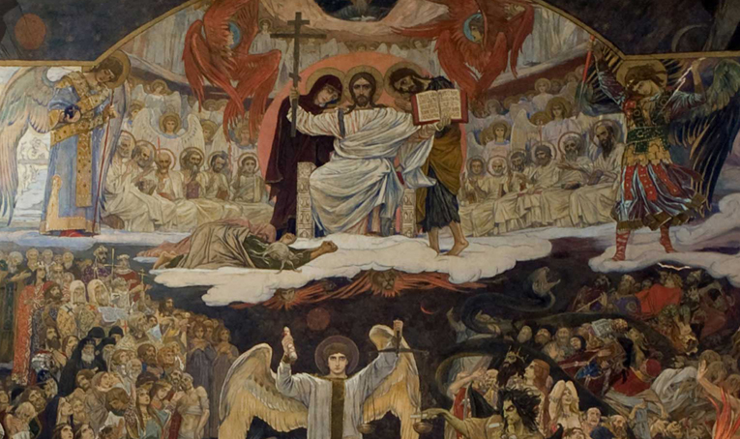
Chapter 4
The Messiah
Notes:
Chapter 4
The Messiah
_________________
The Last Judgement by Viktor Vasnetsov 1904

Slide 109
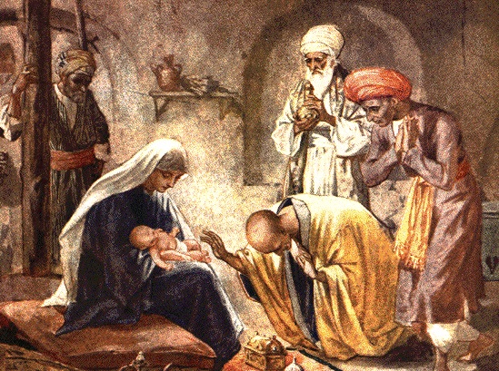
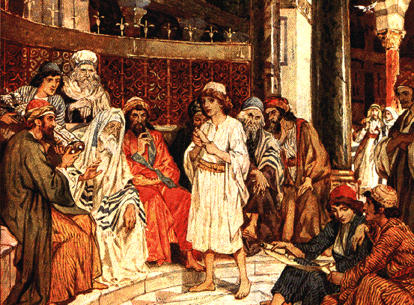
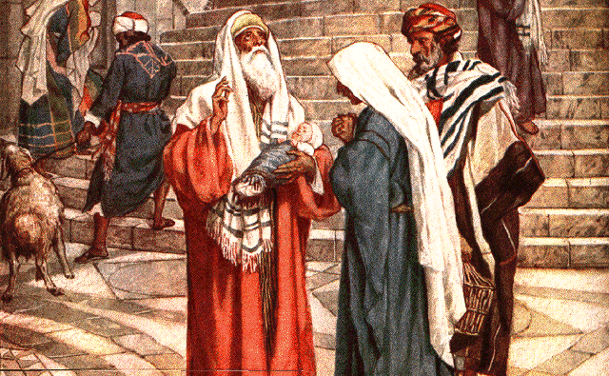
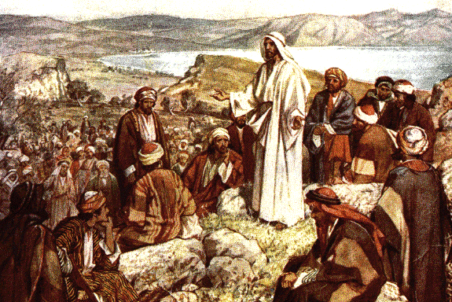
Salvation through the Cross
•
Jesus came as the Messiah in order to establish the Kingdom of Heaven on the earth.
Notes:
Jesus came as the Messiah in order to establish the Kingdom of Heaven on the earth.
____________________________________
-Wise men worshipping Jesus - by William Brassey Hole (1846–1917)
-The boy Jesus asking questions in the Temple - by William Brassey Hole (1846–1917)
-Simeon blessing Jesus in the Temple - by by William Brassey Hole (1846–1917)
-The Sermon on the Mount from The Life of Jesus of Nazareth by William Brassey Hole (1846–1917)

Slide 110
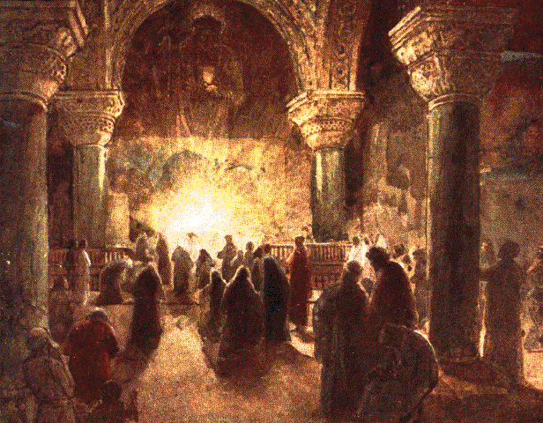
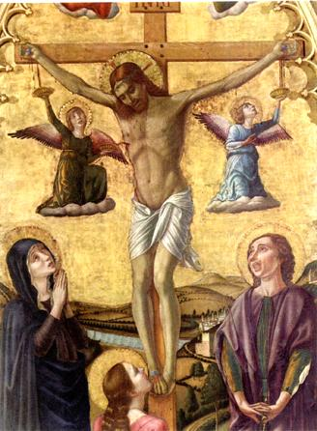
Salvation through the Cross
Perfect
person
Kingdom of Heaven
::::::
?
Jesus
Believers
•
Did Jesus’ crucifixion enable faithful believers in Jesus to become perfect and build the Kingdom of Heaven on earth?
Notes:
Did Jesus’ CRUCIFIXION enable faithful BELIEVERS in Jesus to become PERFECT and build the KINGDOM of Heaven on earth?

Slide 111
Salvation through the Cross
Perfect
person
Kingdom of Heaven
::::::
?
Believers
Jesus
1
No oneness with God
Believers
1
There has been no one who lived his life in inseparable oneness with God.
Notes:
1. There has been no one who lived his life in inseparable ONENESS with God.
__________________________
Early Christians Worshipping by William Brassey Hole (1846–1917)

Slide 112
Salvation through the Cross
Perfect
person
Kingdom of Heaven
::::::
?
Believers
Jesus
1
No oneness with God
2
Need redemption,
prayer,
and devotion
Believers
2
There has never been a believer who had no need of redemption or a life of ardent prayer and devotion.
Notes:
2. There has never been a believer who had no NEED OF redemption or a life of ardent prayer and devotion.

Slide 113
Salvation through the Cross
Perfect
person
Kingdom of Heaven
::::::
?
Believers
Jesus
1
No oneness with God
2
Need redemption,
prayer,
and devotion
Believers
3
Transmit original sin
3
Christian parents continue to transmit the original sin to their children.
Notes:
3. Christian parents continue to TRANSMIT the original sin to their children.

Slide 114
Salvation through the Cross
Perfect
person
Kingdom of Heaven
::::::
?
Believers
Jesus
1
No oneness with God
2
Need redemption,
prayer,
and devotion
Believers
3
Transmit original sin
Not perfectly restored original nature
•
This teaches us that the cross has
not perfectly restored our original nature.
Notes:
This teaches us that the cross has not PERFECTLY restored our original nature.

Slide 115
Jesus’ death on the cross
•
Was Jesus’ death on the cross the most desired Will of God?
Notes:
Was Jesus’ death on the cross the most desired Will of God?

Slide 116
Jesus’ death on the cross
Disciples
51 "You stiff-necked people, uncircumcised in heart and ears, you always resist the Holy Spirit. As your fathers did, so do you. ”
52 Which of the prophets did not your fathers persecute? And they killed those who announced beforehand the coming of the Righteous One, whom you have now betrayed and murdered,
53 you who received the law as delivered by angels and did not keep it."
1
(Acts 7:51-53)
RSV (Acts. 7:51-53)
1
Judging from the words and deeds of the disciples as recorded in the Bible, concerning the death of Jesus, they were unanimously grief-stricken and indignant (Acts 7:51-53).
Notes:
1. Judging from the WORDS and deeds of the disciples as recorded in the Bible, concerning the death of Jesus, they were unanimously grief-striken and indignant (ACTS 7:51-53).

Slide 117
Jesus’ death on the cross
Disciples
1
(Acts 7:51-53)
2
God
2
Judging from the viewpoint of God’s providence, God called the chosen people of Israel and prepared them to receive the Messiah.
Notes:
2. Judging from the VIEWPOINT of God’s providence, God called the chosen people of Israel and prepared them to receive the Messiah.

Slide 118
Jesus’ death on the cross
Disciples
1
(Acts 7:51-53)
Jesus answered them, "This is the work of God, that you believe in him whom he has sent."
2
God
RSV (John 6:29)
Jesus
3
(John 6:29, Matt. 23:37, John 10:38)
3
The words and deeds of Jesus himself were meant to engender belief on the part of the people that he was the Messiah (John 6:29, Matt. 23:37, John 10:38).
Notes:
3. The WORDS and deeds of Jesus himself were meant to engender belief on the part of the people that he was the Messiah (John 6:29, Matt, 23:37, John 10:38).

Slide 119
Jesus’ death on the cross
Disciples
1
(Acts 7:51-53)
"O Jerusalem, Jerusalem, killing the prophets and stoning those who are sent to you! How often would I have gathered your children together as a hen gathers her brood under her wings, and you would not!
2
God
Jesus
3
(John 6:29, Matt. 23:37, John 10:38)
RSV (Matt. 23:37)
3
The words and deeds of Jesus himself were meant to engender belief on the part of the people that he was the Messiah (John 6:29, Matt. 23:37, John 10:38).
Notes:
(Matt. 23:37)

Slide 120
Jesus’ death on the cross
Disciples
1
(Acts 7:51-53)
but if I do them, even though you do not believe me, believe the works, that you may know and understand that the Father is in me and I am in the Father."
2
God
Jesus
RSV (John 10:38)
3
(John 6:29, Matt. 23:37, John 10:38)
3
The words and deeds of Jesus himself were meant to engender belief on the part of the people that he was the Messiah (John 6:29, Matt. 23:37, John 10:38).
Notes:
(John 10:38)

Slide 121
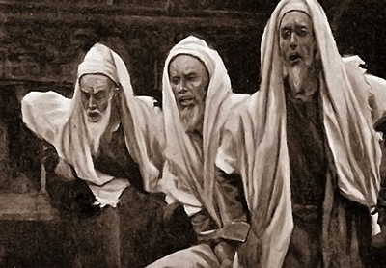
Jesus’ death on the cross
Disciples
1
(Acts 7:51-53)
Ignorance
& Disbelief
of the
People
2
God
Jesus
3
(John 6:29, Matt. 23:37, John 10:38)
•
From all the above evidence, we can deduce that Jesus’ death on the cross was the unfortunate outcome of the ignorance and disbelief of the people of his day, and not a necessary outcome of God’s predestination.
Notes:
From all the above evidence, we can deduce that JESUS’ death on the cross was the unfortunate outcome of the IGNORANCE and disbelief of the people of his day, and not a necessary outcome of God’s predestination.
_____________________________
Picture: The Pharisees Accusing Jesus by James J.J.Tissot

Slide 122
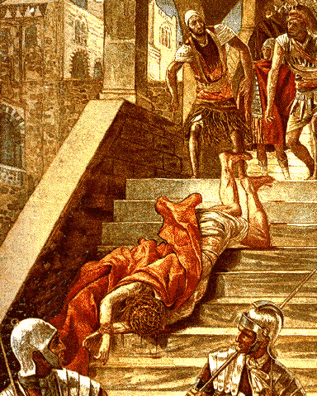
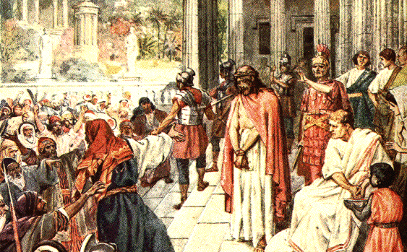
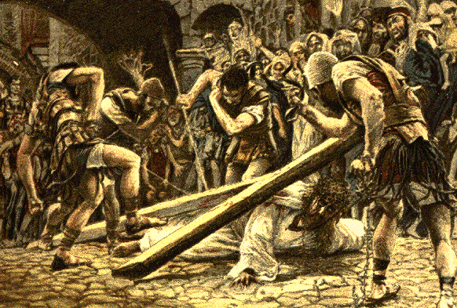
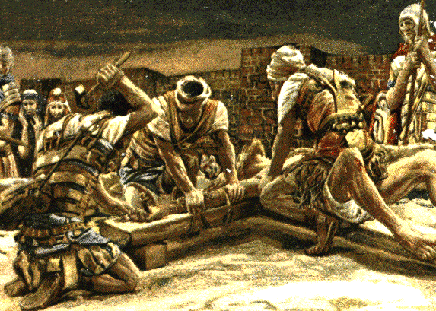
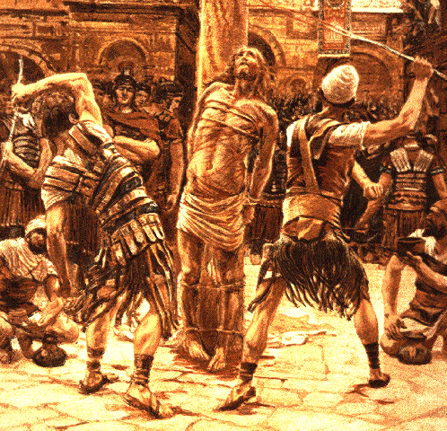
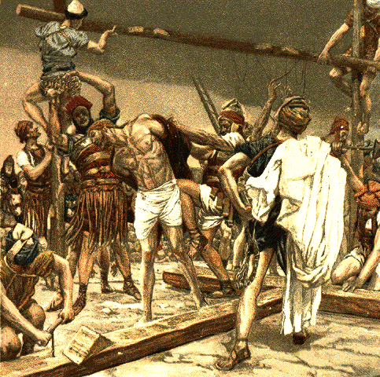
Limit of salvation through the cross and Jesus’ Second Coming
Body :
Satan’s
assault
No
Physical
salvation
•
The people led him to the cross. Jesus’ body took Satan’s assault, and he was killed. Consequently, Christians cannot attain physical salvation.
Notes:
The people led him to the cross. Jesus’ BODY took Satan’s assault, and he was killed. Consequently, Christians cannot attain PHYSICAL salvation.
____________________________
Top fr. left:
-Scala Sancta, from The Life of Jesus Christ (1899) by J.J.Tissot (1836-1902)
-Behold the Man - by William Brassey Hole (1846–1917)
-Christ Falls beneath His Cross by J.J.Tissot (1836-1902)
Bottom fr. Left:
-The First Nail by J.J.Tissot (1836-1902)
-Scourging of the Face by J.J.Tissot (1836-1902)
-Jesus stripped of His raiment by J.J.Tissot (1836-1902)

Slide 123
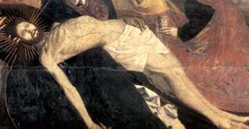
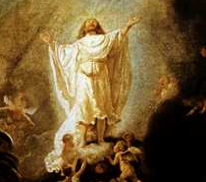
Limit of salvation through the cross and Jesus’ Second Coming
Spirit: basis
for
salvation
>
Body :
Satan’s
assault
No
Physical
salvation
•
However, Jesus laid the basis for spiritual salvation by securing the victorious foundation for his resurrection through the redemption by his blood on the cross.
Notes:
However, Jesus laid the BASIS for spiritual salvation by securing the victorious foundation for his RESURRECTION through the redemption by his blood on the CROSS.

Slide 124
Limit of salvation through the cross and Jesus’ Second Coming
Spirit: basis
for
salvation
Spiritual
salvation
Believers
>
Body :
Satan’s
assault
No
Physical
salvation
As a result, all believers since his resurrection have received the benefit of spiritual salvation.
Notes:
As a result, all BELIEVERS since his resurrection have received the benefit of SPIRITUAL salvation.
__________________________
Early Christians Worshipping by William Brassey Hole (1846–1917)

Slide 125
Limit of salvation through the cross and Jesus’ Second Coming
Spirit: basis
for
salvation
Spiritual
salvation
Believers
>
Body :
Satan’s
assault
No
Physical
salvation
Coming
Second
:
Complete Spiritual and
physical salvation
•
To complete the work of spiritual and physical salvation, Jesus must come again on earth.
Notes:
To complete the work of SPIRITUAL and physical salvation, Jesus must COME again on earth.

Slide 126
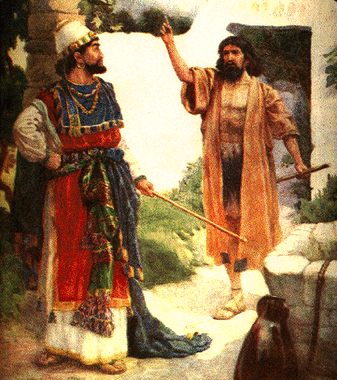
The second coming of Elijah and John the Baptist
Elijah
Malachi
”Behold, I will send you Elijah before the great and terrible day of the Lord comes”
Come
again
(Mal. 4:5)
Mal. 4:5
•
The Jews of Jesus’ day were waiting for Elijah because God had promised through prophet Malachi that Elijah would return before the advent of the Messiah.
Notes:
The Jews of Jesus’ day were waiting for ELIJAH because God had promised through prophet MALACHI that ELIJAH would return before the advent of the Messiah.
__________________________
Elijah and Ahab in Naboth´s Vineyard, by C.F. Vos

Slide 127
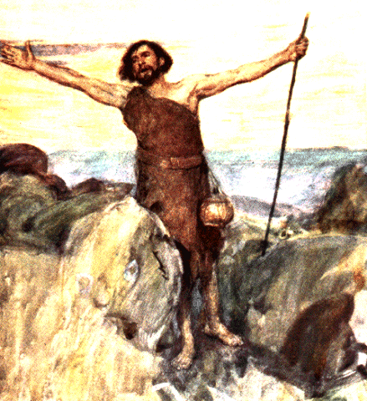
The second coming of Elijah and John the Baptist
Elijah
“…and if you are willing to accept it, he is Elijah who is to come. …”
Malachi
Come
again
Jesus
(Mal. 4:5)
(
)
Matt. 11:14
Matt. 11:14
John
the Baptist
Matt. 17:13
Returning
Elijah
___________
___________
•
Jesus testified that the prophesied coming of Elijah was realized in John the Baptist (Matt. 11:14, 17:13)
Notes:
JESUS testified that the prophesied coming of ELIJAH was realized in JOHN the baptist (Matt. 11:14, 17:13)

Slide 128
The second coming of Elijah and John the Baptist
Elijah
…”Elijah does come, and he is to restore all things; …” Then the disciples understood that he was speaking to them of John the Baptist.
Malachi
Come
again
Jesus
(Mal. 4:5)
(
)
Matt. 11:14
John
the Baptist
Matt. 17:13
Matt. 17:13
Returning
Elijah
___________
___________
•
Jesus testified that the prophesied coming of Elijah was realized in John the Baptist (Matt. 11:14, 17:13)
Notes:
Matt. 17:13

Slide 129
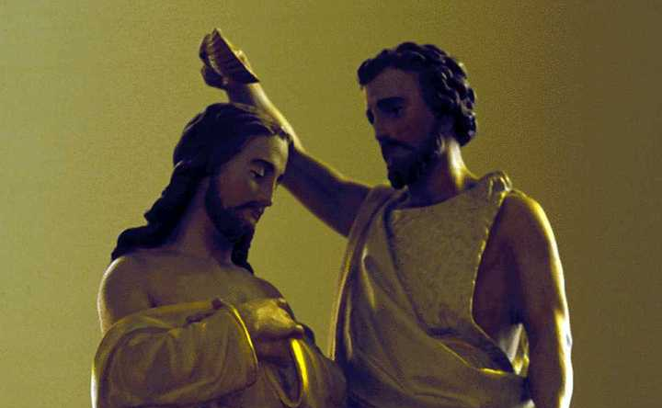
The faithlessness of John the Baptist
John
the Baptist
Jewish people
•
Many among the Jewish leadership and Jewish people had the highest respect for John the Baptist; some even thought of him as the Messiah.
Notes:
Many among the Jewish leadership and JEWISH people had the highest respect for JOHN the baptist; some even thought of him as the Messiah.

Slide 130
The faithlessness of John the Baptist
Jesus
Elijah
John
the Baptist
Announce
Jewish people
•
Had John the Baptist announced that he was Elijah, as Jesus had testified, all the Jewish people would have readily believed John’s testimony and flocked to Jesus.
Notes:
Had John the Baptist ANNOUNCED that he was Elijah, as Jesus had testified, all the Jewish people would have readily believed John’s testimony and flocked to JESUS.
(This text is not in the original one hour lecture)

Slide 131
The faithlessness of John the Baptist
Jesus
And this is the testimony of John, when the Jews sent priests and Levites from Jerusalem to ask him, “Who are you?”
He confessed, he did not deny, but confessed, “I am not the Christ.”
And they asked him, “What then?
Are you Elijah?” He said, ”I am not.”
Elijah
Elijah
John
the Baptist
Announce
Deny
Jewish people
John 1:19-21
•
But in ignorance of God’s providence, John denied his being Elijah, which became the principal reason why the Jewish people rejected Jesus.
Notes:
But in ignorance of God’s providence, John DENIED his being Elijah, which became the principal reason why the Jewish people REJECTED Jesus.

Slide 132
The faithlessness of John the Baptist
Jesus
Elijah
Elijah
John
the Baptist
Announce
Deny
Jewish people
•
Here we can understand that the main reason why Jesus had to die on the cross was the failure of John the Baptist.
Notes:
Here we have come to understand that the main reason why Jesus had to die on the cross was the failure of JOHN the Baptist.

Slide 133
Key Points
God’s Kingdom, not the cross, was Jesus’ original mission
Through the cross we have spiritual salvation
John the Baptist’s failure was the main reason Jesus had to go the way of the cross
Notes:
Key Points

Slide 135
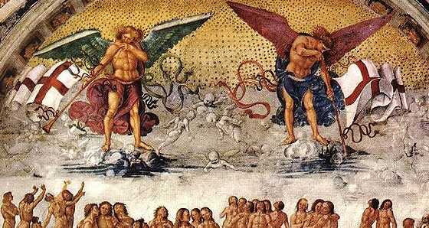
Chapter 5
Resurrection
Notes:
Chapter 5
Resurrection
_______________________
Luca Signorelli - Resurrection of the Flesh (1499-1502)

Slide 136
Resurrection
Come back to life
_
_
•
Resurrection means to come back to life. To come back to life implies that we have been dead.
Notes:
Here, death means the DEATH caused by the fall.

Slide 137
Resurrection
Come back to life
_
_
Death :
death caused by the Fall
•
Here, death means the death caused by the Fall.
Notes:
Here, death means the DEATH caused by the fall.

Slide 138

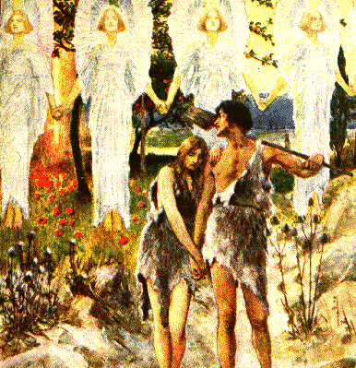
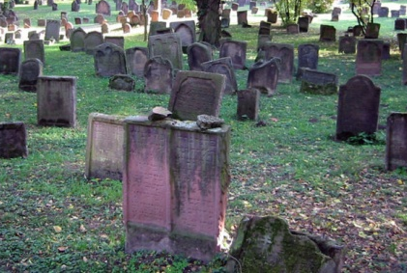

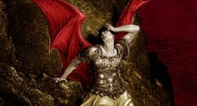
Resurrection
Come back to life
_
_
Death :
death caused by the Fall
Death
caused
by the
Fall
“…for in the day that you eat of it you shall die.”
Death
RSV (Gen. 3:7)
Eat
Satan’s
(Illicit Love)
dominion
Gen. 3:7
The fruit
•
The death caused by the Fall does not mean the end of physical life, but rather the descent into the evil dominion of Satan through eating of the fruit.
Notes:
Here, death means the DEATH caused by the fall.

Slide 139
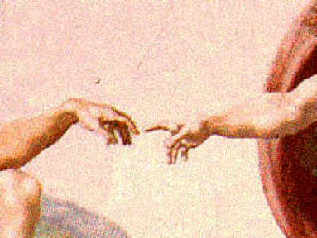
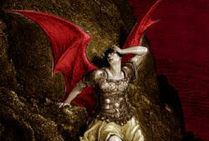
The Meaning of Resurrection
Life
Death
Fall
Satan’s dominion
God's direct
dominion
Resurrection
Process of restoration
•
Resurrection may be defined as the process of being restored from the death caused by the Fall to life, from Satan’s dominion to God’s direct dominion, through the providence of restoration.
Notes:
Resurrection may be defined as the PROCESS of being restored from the DEATH caused by the Fall to life, from SATAN’S dominion to GOD’S direct dominion, through the providence of restoration.
_______________________________
Gustave Doré's depiction of Satan from John Milton's ‘Paradise Lost’.

Slide 140
2.1
How Does God Carry Out His Work of Resurrection?
Providence
Providence
Providence
___________
___________
of Resurrection
___________
of Restoration
___________
of Re-creation
Original person
Resurrection
Fallen person
•
The providence of resurrection is the providence of restoration, and thus the providence of re-creation. Thus, the providence of resurrection is carried out in accordance with the Principle of Creation:
Notes:
Resurrection may be defined as the PROCESS of being restored from the DEATH caused by the Fall to life, from SATAN’S dominion to GOD’S direct dominion, through the providence of restoration.
_______________________________
Gustave Doré's depiction of Satan from John Milton's ‘Paradise Lost’.

Slide 141
2.1
How Does God Carry Out His Work of Resurrection?
Providence
Providence
Providence
___________
___________
of Resurrection
___________
of Restoration
___________
of Re-creation
Original person
1
Merit of the age
Resurrection
Fallen person
1
First, the merit of the age has increased in proportion to the foundation of heart laid by the prophets, sages and righteous people who came before us, and the subsequent generations benefit from the merit of the age.
Notes:
Resurrection may be defined as the PROCESS of being restored from the DEATH caused by the Fall to life, from SATAN’S dominion to GOD’S direct dominion, through the providence of restoration.
_______________________________
Gustave Doré's depiction of Satan from John Milton's ‘Paradise Lost’.

Slide 142
2.1
How Does God Carry Out His Work of Resurrection?
Providence
Providence
Providence
___________
___________
of Resurrection
___________
of Restoration
___________
of Re-creation
Original person
1
Merit of the age
2
Believe and practice the Word
Resurrection
Fallen person
2
Second, God’s responsibility is to give us His Word and guidance, and our responsibility is to believe and practice it.
Notes:
Resurrection may be defined as the PROCESS of being restored from the DEATH caused by the Fall to life, from SATAN’S dominion to GOD’S direct dominion, through the providence of restoration.
_______________________________
Gustave Doré's depiction of Satan from John Milton's ‘Paradise Lost’.

Slide 143
2.1
How Does God Carry Out His Work of Resurrection?
Providence
Providence
Providence
___________
___________
of Resurrection
___________
of Restoration
___________
of Re-creation
Original person
1
Merit of the age
2
Believe and practice the Word
Resurrection
3
Earthly Life
Fallen person
3
Third, the resurrection of a spirit can be achieved only through earthly life, in the physical self.
Notes:
Resurrection may be defined as the PROCESS of being restored from the DEATH caused by the Fall to life, from SATAN’S dominion to GOD’S direct dominion, through the providence of restoration.
_______________________________
Gustave Doré's depiction of Satan from John Milton's ‘Paradise Lost’.

Slide 144
2.1
How Does God Carry Out His Work of Resurrection?
Providence
Providence
Providence
___________
___________
of Resurrection
___________
of Restoration
___________
of Re-creation
Original person
________________
1
Merit of the age
___________
Believe and practice the Word
2
Resurrection
3
Earthly Life
___________
4
Three ordered stages
________________
Fallen person
4
Fourth, the providence of resurrection is to be completed through three ordered stages.
Notes:
Resurrection may be defined as the PROCESS of being restored from the DEATH caused by the Fall to life, from SATAN’S dominion to GOD’S direct dominion, through the providence of restoration.
_______________________________
Gustave Doré's depiction of Satan from John Milton's ‘Paradise Lost’.

Slide 145
Key Points
God designed us to live briefly on earth and eternally in the spiritual world
Resurrection means to move from spiritual death to spiritual life
Resurrection means to move from Satan’s dominion to God’s dominion
Notes:
Key Points

Slide 147
Chapter 6
Predestination
Notes:
Chapter 6
Predestination

Slide 148
Theological controversy over predestination
Confusion in religious life
•
Theological controversy over predestination has caused great confusion in the religious lives of many people.
Notes:
Theological controversy over predestination has caused great confusion in the religious lives of many people.

Slide 149

Theological controversy over predestination
Confusion in religious life
Affirm
predestination
29 For those whom he foreknew he also predestined ….
30 And those whom he predestined he also called; and those whom he called he also justified; and those whom he justified he also glorified.
Rom. 8:29-30
Prosperity and decline
Rom. 9:15-16
Happiness and misery
Rom. 9:21
Salvation and damnation
Rom. 9:11
RSV (Rom. 8:29-30)
Rise and fall of nations
•
In the Bible, we find many passages which are often interpreted to mean that everything in human life comes to pass exactly as predestined by God.
Notes:
In the Bible, we find many passages which are often interpreted to mean that EVERYTHING in human life comes to pass exactly as PREDESTINED by God.
-----------------------------
(Rom. 8:29-30)
29 For those whom he foreknew he also predestined ….
30 And those whom he predestined he also called; and those whom he called he also justified; and those whom he justified he also glorified.

Slide 150
Theological controversy over predestination
Confusion in religious life
Affirm
predestination
15 For he says to Moses, "I will have mercy on whom I have mercy, and I will have compassion on whom I have compassion."
16 So it depends not upon man's will or exertion, but upon God's mercy.
Rom. 8:29-30
Prosperity and decline
Rom. 9:15-16
Happiness and misery
Rom. 9:21
Salvation and damnation
Rom. 9:11
RSV (Rom. 9:15-16)
Rise and fall of nations
•
In the Bible, we find many passages which are often interpreted to mean that everything in human life comes to pass exactly as predestined by God.
Notes:
(Rom. 9:15-16)
15 For he says to Moses, "I will have mercy on whom I have mercy, and I will have compassion on whom I have compassion."
16 So it depends not upon man's will or exertion, but upon God's mercy.

Slide 151
Theological controversy over predestination
Confusion in religious life
Affirm
predestination
Has the potter no right over the clay, to make out of the same lump one vessel for beauty and another for menial use?
Rom. 8:29-30
Prosperity and decline
Rom. 9:15-16
Happiness and misery
Rom. 9:21
Salvation and damnation
Rom. 9:11
RSV (Rom. 9:21)
Rise and fall of nations
•
In the Bible, we find many passages which are often interpreted to mean that everything in human life comes to pass exactly as predestined by God.
Notes:
(Rom. 9:21)
Has the potter no right over the clay, to make out of the same lump one vessel for beauty and another for menial use?

Slide 152
Theological controversy over predestination
Confusion in religious life
Affirm
predestination
though they were not yet born and had done nothing either good or bad, in order that God's purpose of election might continue, not because of works but because of his call,
Rom. 8:29-30
Prosperity and decline
Rom. 9:15-16
Happiness and misery
Rom. 9:21
Salvation and damnation
Rom. 9:11
Rise and fall of nations
RSV (Rom. 9:11)
•
In the Bible, we find many passages which are often interpreted to mean that everything in human life comes to pass exactly as predestined by God.
Notes:
(Rom. 9:11)
though they were not yet born and had done nothing either good or bad, in order that God's purpose of election might continue, not because of works but because of his call,

Slide 153
Theological controversy over predestination
Confusion in religious life
Affirm
predestination
Refute
predestination
but of the tree of the knowledge of good and evil you shall not eat, for in the day that you eat of it you shall die."
Rom. 8:29-30
Prosperity and decline
Gen. 2:17
Rom. 9:15-16
Happiness and misery
Gen. 6:6
Rom. 9:21
Matt. 7:7
Salvation and damnation
Rom. 9:11
James 5:14
RSV (Gen. 2:17)
Rise and fall of nations
•
Yet we can find sufficient evidence in the Bible to refute the doctrine of absolute predestination.
Notes:
Yet we can find sufficient evidence in the Bible to REFUTE the doctrine of absolute predestination.

Slide 154
Theological controversy over predestination
Confusion in religious life
Affirm
predestination
Refute
predestination
And the LORD was sorry that he had made man on the earth, and it grieved him to his heart.
Rom. 8:29-30
Prosperity and decline
Gen. 2:17
Rom. 9:15-16
Happiness and misery
Gen. 6:6
Rom. 9:21
Matt. 7:7
Salvation and damnation
Rom. 9:11
James 5:14
RSV (Gen. 6:6)
Rise and fall of nations
•
Yet we can find sufficient evidence in the Bible to refute the doctrine of absolute predestination.
Notes:
Gen 6:6

Slide 155
Theological controversy over predestination
Confusion in religious life
Affirm
predestination
Refute
predestination
"Ask, and it will be given you; seek, and you will find; knock, and it will be opened to you.
Rom. 8:29-30
Prosperity and decline
Gen. 2:17
Rom. 9:15-16
Happiness and misery
Gen. 6:6
Rom. 9:21
Matt. 7:7
Salvation and damnation
Rom. 9:11
RSV (Matt. 7:7)
James 5:14
Rise and fall of nations
•
Yet we can find sufficient evidence in the Bible to refute the doctrine of absolute predestination.
Notes:
Matt. 7:7

Slide 156
Theological controversy over predestination
Confusion in religious life
Affirm
predestination
Refute
predestination
Is any among you sick? Let him call for the elders of the church, and let them pray over him, anointing him with oil in the name of the Lord;
Rom. 8:29-30
Prosperity and decline
Gen. 2:17
Rom. 9:15-16
Happiness and misery
Gen. 6:6
Rom. 9:21
Matt. 7:7
Salvation and damnation
Rom. 9:11
James 5:14
Rise and fall of nations
RSV (James 5:14)
•
Yet we can find sufficient evidence in the Bible to refute the doctrine of absolute predestination.
Notes:
James 5:14

Slide 157
Theological controversy over predestination
Confusion in religious life
Affirm
predestination
Refute
predestination
Rom. 8:29-30
Prosperity and decline
Gen. 2:17
Rom. 9:15-16
Happiness and misery
Gen. 6:6
Rom. 9:21
Matt. 7:7
Salvation and damnation
Rom. 9:11
James 5:14
Rise and fall of nations
•
How does the Divine Principle resolve this issue?
Notes:
How does the Divine Principle resolve this issue?

Slide 158
The predestination of God’s Will
Creation
God
God's Will
_
_
Restoration
•
God could not accomplish His purpose of creation due to the human Fall. Accordingly, God’s Will in carrying out His providence for fallen humanity is still to accomplish the purpose of creation. In this sense, God‘s Will is that restoration be accomplished.
Notes:
God could not accomplish His purpose of creation due to the human Fall. Accordingly, GOD’S Will in carrying out His providence for fallen humanity is still to accomplish the purpose of CREATION. In this sense, God‘s Will is that RESTORATION be accomplished.

Slide 159
The predestination of God’s Will
Creation
God
God's Will
_
_
Restoration
……
……
Absolute,
unique,
Absolute,
unique,
eternal, and
eternal, and
unchanging
unchanging
•
God is the absolute, unique, eternal and unchanging Being; therefore, His Will must also be absolute, unique, eternal, and unchanging.
Notes:
God is the ABSOLUTE, unique, eternal and unchanging Being; therefore, His Will must also be ABSOLUTE, unique, eternal, and unchanging.

Slide 160
The predestination of God’s Will
Creation
God
God's Will
_
_
Restoration
……
……
Absolute,
unique,
Absolute,
unique,
eternal, and
eternal, and
unchanging
unchanging
Predestination of God’s Will :
absolute
•
The predestination of God’s Will is absolute.
Notes:
The PREDESTINATION of God’s Will is ABSOLUTE.

Slide 161





The Predestination of
the Fulfillment of
God's Will
and
the Predestination of
Human Beings
Notes:
The Predestination of the Fulfillment of God's Will and the Predestination of Human Beings

Slide 162


Providence
of restoration
God's Will
Absolute
……...
Fulfillment
of
God’s Will
Human
responsibility
•
Although God’s Will of the providence of restoration is absolute and beyond human influence, its fulfillment necessarily requires the accomplishment of the human portion of responsibility.
Notes:
Although GOD’S Will of the providence of restoration is ABSOLUTE and beyond human influence, its FULFILLMENT necessarily requires the accomplishment of the HUMAN portion of responsibility.

Slide 163

Providence
of restoration
God's Will
Absolute
……...
Fulfillment
of
God’s Will
God’s
responsibility
Human
responsibility
-
+
-
100 %
95 %
5 %
•
God predestines the process of its fulfillment conditionally, contingent upon the completion of the 5% human responsibility in addition to the 95% responsibility of God.
Notes:
God predestines the process of its FULFILLMENT conditionally, contingent upon the completion of the 5% HUMAN responsibility in addition to the 95% RESPONSIBILITY of God.

Slide 164
Providence
of restoration
God's Will
Absolute
……...
Fulfillment
of
God’s Will
God’s
responsibility
Human
responsibility
-
+
-
100 %
95 %
5 %
conditional
Predestination of the fulfillment of God’s Will :
•
Therefore, the predestination of the fulfillment of God’s Will is conditional.
Notes:
Therefore, the PREDESTINATION of the fulfillment of God’s Will is CONDITIONAL.

Slide 165
Providence
of restoration
God's Will
Absolute
……...
Fulfillment
of
God’s Will
God’s
responsibility
Human
responsibility
-
+
-
100 %
95 %
5 %
conditional
Predestination of the fulfillment of God’s Will :
conditional
Predestination of human beings :
•
And the predestination of human beings is conditional.
Notes:
And the PREDESTINATION of human beings is CONDITIONAL.

Slide 166
Elucidation of verses which support absolute predestination
Rom. 8:29-30
(Words about human responsibility omitted)
Foreknow
Predestine
Justify
Glorify
+
Call
•
The book of Romans says: For those whom He foreknew He also predestined… those whom He predestined He also called; and those whom He called He also justified; and those whom He justified He also glorified (Rom. 8:29-30).
Notes:
The book of ROMANS says: For those whom He foreknew He also predestined…those whom He predestined He also CALLED; and those whom He called He also JUSTIFIED; and those whom He justified He also GLORIFIED (Rom. 8:29-30).

Slide 167
Elucidation of verses which support absolute predestination
Rom. 8:29-30
(Words about human responsibility omitted)
Foreknow
Predestine
Justify
Glorify
+
Call
God’s
responsibility
Human
responsibility
+
•
Predestining and calling the person is God’s responsibility, but only when the person completes his responsibility after being called by God is he justified.
Notes:
Predestining and calling the person is GOD’S responsibility, but only when the person completes his RESPONSIBILITY after being called by God is he justified.

Slide 168
Elucidation of verses which support absolute predestination
Rom. 8:29-30
(Words about human responsibility omitted)
Foreknow
Predestine
Justify
Glorify
+
Call
God’s
responsibility
Human
responsibility
+
Fulfillment
•
Hence, God’s predestination concerning an individual’s glorification is thus contingent upon the fulfillment of his portion of responsibility.
Notes:
Hence, God’s predestination concerning an individual’s GLORIFICATION is thus contingent upon the FULFILLMENT of his portion of responsibility.

Slide 169
Key Points
God’s Will is absolutely predestined
The fulfillment of God’s will is conditional based on the fulfillment of human responsibility
Notes:
Key Points

Slide 171

Chapter 7
Christology
Notes:
Chapter 7
Christology
________________________
Wall Painting in Georgia's ancient Monastery, Shio-Mghvime

Slide 172
Issues of Christology
}
God
Doctrine of Trinity
Jesus
Holy
Spirit
}
Doctrine of Rebirth
Fallen
People
•
Issues which fall within the scope of Christology include the Trinity, which deals with the relationship between God, Jesus and the Holy Spirit; and rebirth, which concerns the relationship between Jesus, the Holy Spirit and fallen people.
Notes:
Issues which fall within the scope of Christology include the TRINITY, which deals with the relationship between GOD, JESUS and the HOLY Spirit; and REBIRTH, which concerns the relationship between JESUS, the HOLY Spirit and FALLEN people.

Slide 173
The value of a person who has realized the purpose of creation
God
1
Divine value
Mind
Body
2
Unique existence
3
Value of the entire cosmos
Person
Perfect person
•
A perfect person, who has realized the purpose of creation:
1
Assumes a divine value, comparable to God.
2
Is a unique existence in the cosmos.
3
Has the value of the entire cosmos.
Notes:
A PERFECT person, who has realized the purpose of creation:
1. Assumes a DIVINE value, comparable to God.
2. Is a UNIQUE existence in the cosmos.
3. Has the VALUE of the entire cosmos.

Slide 174

Jesus and the person who has realized the Purpose of Creation
Value of a perfect person
Value of Jesus
……
……
Perfect
person
Jesus
•
There is no greater value than the value of a person who has realized the ideal of creation. This is the value of Jesus, who surely attained the highest imaginable value.
Notes:
There is no greater value than the VALUE of a person who has realized the ideal of creation. This is the VALUE of Jesus, who surely attained the highest imaginable value.

Slide 175
Jesus and the person who has realized the Purpose of Creation
Value of a perfect person
Value of Jesus
“For there is one God, and there is one mediator between God and men, the man Christ Jesus.”
……
……
Perfect
person
Jesus
1 Tim. 2:5
1 Tim. 2:5
Jesus
perfect person
=
•
Thus, Jesus is a perfect human being who realized the ideal of creation.
Notes:
Thus, JESUS is a PERFECT human being who realized the ideal of creation.

Slide 176
Is Jesus God Himself?
John 14:9-10
“He who has seen me
has seen the Father.”
•
When Philip asked Jesus to show him God, Jesus said, “He who has seen me has seen the Father; how can you say, ‘Show me the Father?’ Do you not believe that I am in the Father and the Father in me?” (John 14:9-10)
Notes:
When Philip asked Jesus to show him God, Jesus said, “HE WHO HAS seen me has seen the Father; how can you say, ‘Show me the Father?’ Do you not believe that I am in the Father and the Father in me?” (John 14:9-10)

Slide 177
Is Jesus God Himself?
John 14:9-10
“He who has seen me
has seen the Father.”
•
Based on such biblical verses as this, many Christians have believed that Jesus is God, the Creator.
Notes:
Based on such biblical verses as this, many Christians have believed that Jesus is God, the Creator.

Slide 178
Is Jesus God Himself?
John 14:9-10
“He who has seen me
has seen the Father.”
God
Jesus
•
Jesus may well be called God because, as a man who has realized the purpose of creation and who lives in oneness with God, he has a divine nature. Nevertheless he is not God Himself.
Notes:
JESUS may well be called God because, as a man who has realized the purpose of creation and who lives in oneness with GOD, he has a divine nature. Nevertheless he is not God Himself.

Slide 179
Is Jesus God Himself?
John 14:9-10
“He who has seen me
has seen the Father.”
God
God’s
second
self
Not God
Jesus
=
•
The body may be understood to be the mind’s second self, but it is not the mind itself; by analogy, Jesus may be understood to be God’s second self; but he is not God.
Notes:
The body may be understood to be the mind’s second self, but it is not the mind itself; by analogy, Jesus may be understood to be GOD’S second self; but he is NOT God.

Slide 180
Rebirth and the trinity
Jesus and the Holy Spirit and their mission to give rebirth
Rebirth
Born anew
•
Jesus said, “Unless one is born anew, he cannot see the Kingdom of God.” (John 3:3) Why must fallen people be born anew?
Notes:
Jesus said, “Unless one is BORN anew, he cannot see the Kingdom of God.” (John 3:3) Why must fallen people be born anew?

Slide 181
Rebirth and the trinity
Jesus and the Holy Spirit and their mission to give rebirth
Satan
Evil
father
Evil
mother
Adam
Eve
Rebirth
Evil
children
Evil
children
Born anew
•
Adam and Eve fell and became evil parents, multiplying evil children.
Notes:
ADAM and EVE fell and became EVIL parents, multiplying EVIL children.

Slide 182
Rebirth and the trinity
Jesus and the Holy Spirit and their mission to give rebirth
Satan
Evil
father
Evil
mother
Adam
Eve
Rebirth
Born anew
Evil
children
Evil
children
Born anew
•
Hence, fallen people must be born anew as children without original sin.
Notes:
Hence, fallen people must be BORN anew as children without original sin.

Slide 183
Rebirth and the trinity
Jesus and the Holy Spirit and their mission to give rebirth
God
Satan
True
Father
True
Mother
Evil
father
Evil
mother
Jesus
Holy Spirit
Adam
Eve
Rebirth
Good
children
Evil
children
Good
children
Evil
children
Born anew
•
Jesus came as the True Father in order to give rebirth to fallen people, transforming them into good children, thoroughly cleansed of original sin. The Holy Spirit came as the True Mother.
Notes:
JESUS came as the TRUE Father in order to give rebirth to fallen people, transforming them into GOOD children, thoroughly cleansed of original sin. The HOLY Spirit came as the TRUE Mother.

Slide 184
The Trinity
God
Jesus
Holy Spirit
One
•
To fulfill the purpose of creation, Jesus and the Holy Spirit unite through give and take with each other with God as the center and form the four position foundation.
Notes:
To fulfill the purpose of creation, JESUS and the Holy Spirit UNITE through give and take with each other with God as the center and form the FOUR position foundation.

Slide 185
The Trinity
}
God
Trinity
Jesus
Holy Spirit
One
•
God, Jesus and the Holy Spirit thus become one, and this oneness constitutes the Trinity.
Notes:
GOD, JESUS and the HOLY Spirit thus become one, and this oneness constitutes the TRINITY.

Slide 186
Spiritual and perfect trinities
God
Spiritual
True Father
Spiritual
True Mother
Jesus
Holy Spirit
Jesus
Spiritual
children
Spiritual
rebirth
Spiritual trinity
•
Jesus and the Holy Spirit in oneness with God could form only a spiritual trinity and fulfill only the mission of spiritual True Parents.
Notes:
JESUS and the HOLY Spirit in oneness with GOD could form only a spiritual trinity and fulfill only the mission of SPIRITUAL True Parents.

Slide 187
Spiritual and perfect trinities
Spiritual
and
Physical
Spiritual
and
Physical
God
God
Spiritual
True Father
Spiritual
True Mother
True Father
True Mother
Jesus
Holy Spirit
Returning
Christ
Bride
Jesus
…………………………
Spiritual
children
Spiritual
rebirth
Spiritual trinity
•
Christ must return in the flesh and find his Bride. They will form on the earth a perfect trinity with God and become True Parents both spiritually and physically.
Notes:
CHRIST must return in the flesh and find his BRIDE. They will form on the earth a perfect trinity with GOD and become True Parents both spiritually and physically.

Slide 188
Spiritual and perfect trinities
Spiritual
and
Physical
Spiritual
and
Physical
God
God
Spiritual
True Father
Spiritual
True Mother
True Father
True Mother
Jesus
Holy Spirit
Returning
Christ
Bride
Jesus
…………………………
Spiritual
and
physical
rebirth
Spiritual
children
Spiritual
rebirth
Good
children
Spiritual trinity
Trinity on earth
They will give fallen people spiritual and physical rebirth, removing their original sin and enabling them to build trinities on earth with God as the center.
Notes:
They will give fallen people SPIRITUAL and physical rebirth, removing their original sin and enabling them to build TRINITIES on earth with God as the center.

Slide 189
Key Points
Messiah = perfected individual who is one with God
Messiah is not God
We need to be reborn due to the Fall and our fallen lineage
The original Trinity should have been God, Adam and Eve
Notes:
Key Points

Slide 190
This concludes
Part One of the
Exposition of the
Divine Principle

