Slide 2
Welcome

Slide 3
The
Hunger
Within

Slide 4
The Hunger Within
The Present Need for New Insight
Spiritual

Slide 5

Happiness
=
The Fulfillment of Our Desire
Human
Beings
Happiness
DESIRE

Slide 6
Two Aspects of Desire
Mind
Spiritual
Values
Spiritual
Happiness
Goodness
Truth
Love
Beauty
Human
Beings
Shelter
Clothes
Food
Body
Material
Values
Material
Happiness

Slide 7
PURPOSE OF RELIGION & SCIENCE
Spiritual
Values
Truth
Love
Beauty
Good-
ness
Religion
Science
Material
Values
Food
Clothes
Shelter

Slide 8
PURPOSE OF RELIGION & SCIENCE
Spiritual
Values
Internal
Truth
Truth
Purpose
of Life
Good
& Evil
Beauty
Existence
of God
Goodness
Love
Religion
Science
Material
Values
External
Truth
Food
Shelter
Natural
Law
Tech-
nology
Nature
of Matter
Clothes

Slide 9
PURPOSE OF RELIGION & SCIENCE
Spiritual
Values
Internal
Truth
Purpose
of Life
Good
& Evil
Truth
Love
Existence
of God
Beauty
Good-
ness
Religion
Science
Material
Values
External
Truth
Food
Clothes
Natural
Law
Tech-
nology
Shelter
Nature
of Matter

Slide 10
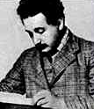
“Religion without science is blind, and science without religion is crippled.”
Albert Einstein
German Physicist

Slide 11
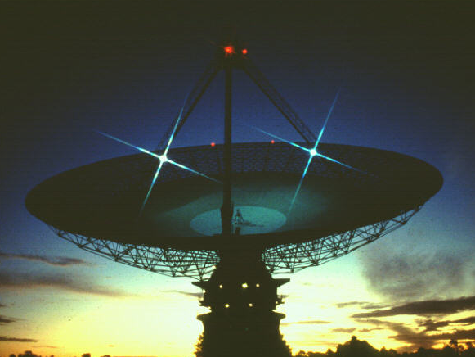

Science
Has brought improvement in the material conditions of Human Life
Cannot solve breakdown of
Human Relationships

Slide 12
Religion
Has brought improvement
in Human Relationships
Lacks understanding to
completely solve breakdown
of Human Relationships

Slide 13
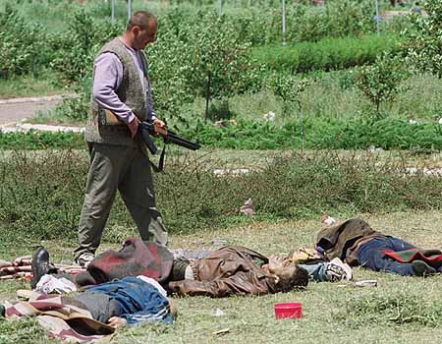
Breakdown of Human Relationships
War

Slide 14
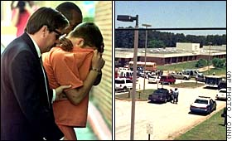
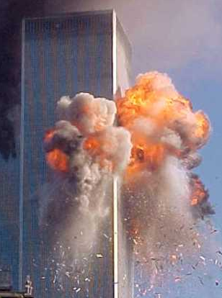
Breakdown of Human Relationships
Crime & Terrorism

Slide 15
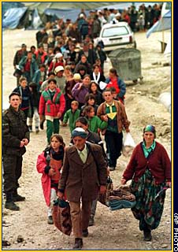
Breakdown of Human Relationships
Ethnic & Racial Discrimination

Slide 16
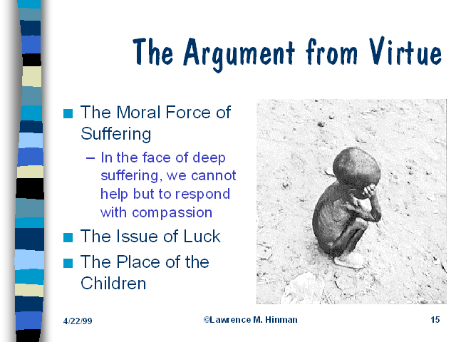
Breakdown of Human Relationships
Hunger & Poverty

Slide 17
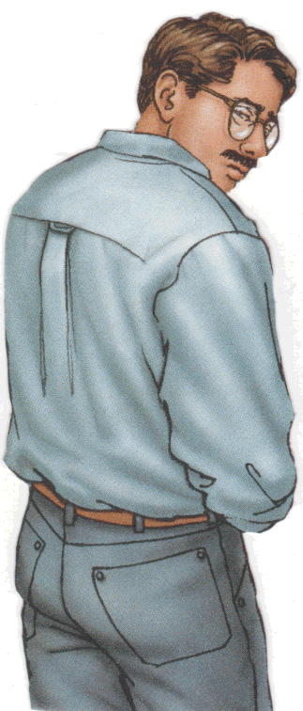
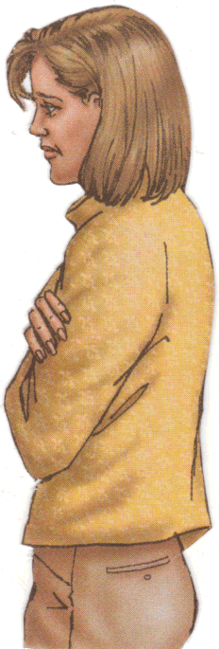

Breakdown of Human Relationships
Family Crises

Slide 18
Breakdown of Human Relationships
Sexual Immorality

Slide 19
Breakdown of Human Relationships
Drug and alcohol abuse

Slide 20

Breakdown of Human Relationships
Pollution

Slide 21
Breakdown of Human Relationships
Ignorance of Internal Truth

Slide 22
Need for New
Understanding
Understanding of Truth
Personal Transformation
True Relationships with Others
Transformation of Society

Slide 23
Need for A New
Expression of Truth
Answer Basic Questions of Life
Existence of God
Purpose of Life
Origin of Evil
Goal of History
Existence After Death

Slide 24
Need for A New
Expression of Truth
Answer Basic Questions of Life
Harmonize Religions and Philosophies
Explain Scriptures
Resolve Conflicts
between Spiritual and
Materialistic Ideologies

Slide 25
Need for A New
Expression of Truth
Answer Basic Questions of Life
Harmonize Religions and Philosophies
Harmonize Religion and Science
Unify the Family
Harmonize Races, Nations and Cultures

Slide 26
“One thing is certain: human beings cannot be improved by more and more laws and regulations… Knowing about things is not the same as knowing about meanings, …laws are not morals…
“What is a world order without… [an] ethic for the whole of humankind…?”
Hans Küng: German Sociologist
Global Responsibility: In Search
of a New World Ethic, 1991

Slide 27
The teachings of
Rev. Dr. Sun Myung Moon
Unification
Principle

Slide 28
The Unification Principle
New Insights
Nature of God
Purpose of Human Life
Life after Death
Purpose & Direction of History

Slide 29
The Unification Principle
New Insights
Nature of God
Age-old questions of concern
Purpose of Human Life
Life after Death
Purpose & Direction of History

Slide 30
The Unification Principle
New Insights
Nature of God
Address fundamental
problems of today
Purpose of Human Life
Life after Death
Purpose & Direction of History

Slide 31
The Unification Principle
1. The Principle of Creation
The Original Ideal
2. The Cause of Human Conflict
The Origin of Evil
3. The Principle of Restoration
The Restoration of the Original Ideal

Slide 32

Family Federation for
World Peace and Unification

Slide 34
Slideshow Presentation by
Eleonore de Watteville

Slide 35
For more information visit
www.unificationstudy.com
E-mail
sacfamfed@aol.com

