Slide 1
Mālō e Lelei

Slide 2
Ko ‘etau fiema’u ‘I loto

Slide 3
ko 'etau fiema'u 'i loto
Koe Fiema’u ‘o ha
Maama
Fakalaumalie
Fo’ou

Slide 4

Koe fiefia
=
Ko Hono Fakakato ‘o ‘Etau Ngāhi Fiema’u
Koe
Tangata
Mo’ui
Fiefia
Fiema’u

Slide 5
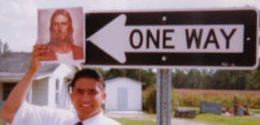
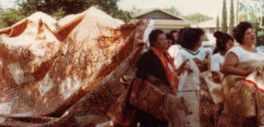
Konga ‘e Ua Hotau Loto
‘Atamai
Koe
Tangata
Mo’ui
Sino

Slide 6
Konga ‘e Ua Hotau Loto
‘Atamai
Koe
Tangata
Mo’ui
‘Api Nofo’anga
Me’akai
‘U Vala
Ngāhi Me’a Mahu’inga
Fakamatelie
Fiefia
Faka-
matelie
Sino

Slide 7
Konga ‘e Ua Hotau Loto
‘Atamai
Ngāhi Me’a Mahu’inga Fakalaumalie
Fiefia
Faka-laumalie
Faka’ofo’ofa
Mo’oni
Lelei
‘Ofa
Koe
Tangata
Mo’ui
Ngāhi Me’a Mahu’inga
Fakamatelie
Fiefia
Faka-
matelie
Sino

Slide 8
KOE TAUMU’A ‘OE LOTU MOE SAIENISI
Ngahi Me’a Mahu’inga Fakalaumalie
Fai-
totonu
‘Ofa
Faka-
‘ofo’ofa
Anga-
lelei
Lotu
Saienisi
Ngahi Me’a Mahu’inga
Fakamatelie
Me’akai
Vala
‘Api
Nofoanga

Slide 9
KOE TAUMU’A ‘OE LOTU MOE SAIENISI
Ngahi Me’a Mahu’inga Fakalaumalie
Mo’oni
Fakalukufua
Faitotonu
Faka’ofo’ofa
Taumu’a
‘oe Mo’ui
Lelei
& Kovi
‘Otua
Mo’ui
Angalelei
Ofa
Lotu
Saienisi
Ngahi Me’a Mahu’inga
Fakamatelie
Mo’oni
Faka-e-Natula
Me’akai
‘Api Nofo’anga
Lao
Faka-
natula
Tekino-
losia
Ngāhi
Misini
Anga
‘oe Me’a
Matelie
Vala

Slide 10
KOE TAUMU’A ‘OE LOTU MOE SAIENISI
Ngahi Me’a Mahu’inga Fakalaumalie
Mo’oni
Fakalukufua
Faitotonu
Faka’ofo’ofa
Taumu’a
‘oe Mo’ui
Lelei
& Kovi
‘Otua
Mo’ui
Angalelei
Ofa
Lotu
Saienisi
Ngahi Me’a Mahu’inga
Fakamatelie
Mo’oni
Faka-e-Natula
Me’akai
‘Api Nofo’anga
Lao
Faka-
natula
Tekino-
losia
Ngāhi
Misini
Anga
‘oe Me’a
Matelie
Vala

Slide 11
KOE TAUMU’A ‘OE LOTU MOE SAIENISI
Ngahi Me’a Mahu’inga Fakalaumalie
Mo’oni
Fakalukufua
Faitotonu
Faka’ofo’ofa
Taumu’a
‘oe Mo’ui
Lelei
& Kovi
‘Otua
Mo’ui
Angalelei
Ofa
Lotu
Saienisi
Ngahi Me’a Mahu’inga
Fakamatelie
Mo’oni
Faka-e-Natula
Me’akai
‘Api Nofo’anga
Lao
Faka-
natula
Tekino-
losia
Anga
‘oe Me’a
Matelie
Vala

Slide 12
KOE TAUMU’A ‘OE LOTU MOE SAIENISI
Ngahi Me’a Mahu’inga Fakalaumalie
Mo’oni
Fakalukufua
Fai-
totonu
‘Ofa
Taumu’a
‘oe Mo’ui
Lelei
& Kovi
Faka-
‘ofo’ofa
Anga-
lelei
‘Otua
Mo’ui
Lotu
Saienisi
Ngahi Me’a Mahu’inga
Fakamatelie
Mo’oni
Faka-e-Natula
Me’akai
Vala
Lao
Faka-
natula
Tekino-
losia
‘Api
Nofoanga
Anga
‘oe Me’a
Matelie

Slide 13
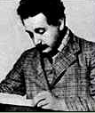
“Koe lotu ta’e kau ai e saienisi ‘oku fai kui pe, pea koe saienisi ta’e kau ai e lotu
‘oku ‘ikai kakato.”
Albert Einstein
Saienisi Siamane

Slide 14
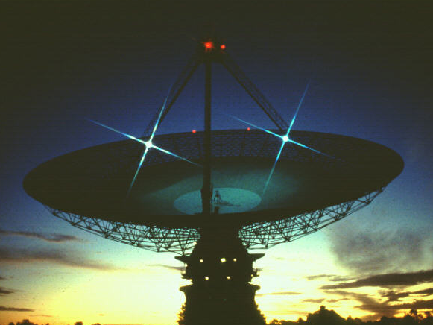
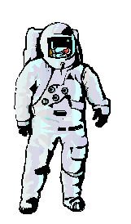
Saienisi
Kuo ne ‘omai e ngahi fakalaka fakamatelie
ki he Mo’ui ‘ae Tangata
Kae ‘ikai lava ‘o solova
e maumau he Ngahi Vā
‘oe Tangata

Slide 15
Lotu
Kuo ne ‘omai e fakalaka
he Ngahi Vā ‘oe Tangata
Ka e kei ta’e mahino aipe
e solova ‘oe maumau he
Ngahi Vā ‘oe Tangata

Slide 16
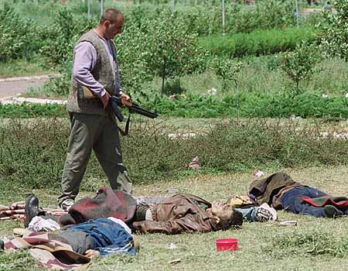
Koe Maumau he Ngahi Vā ‘oe Tangata
Koe Tau moe
Feke’ike’i

Slide 17
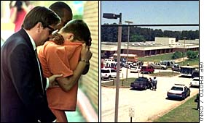
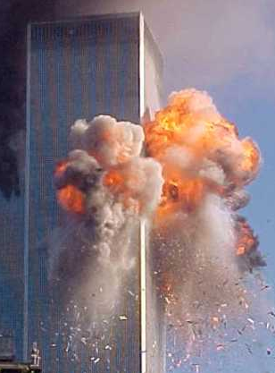
Koe Maumau he Ngahi Vā ‘oe Tangata
Faihia, moe Fakailifia Kovi

Slide 18
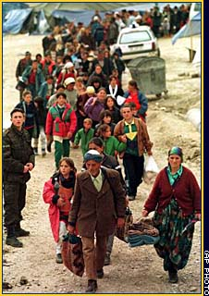
Koe Maumau he Ngahi Vā ‘oe Tangata
Laulanu & Feke’ike’i Fakamatakali

Slide 19
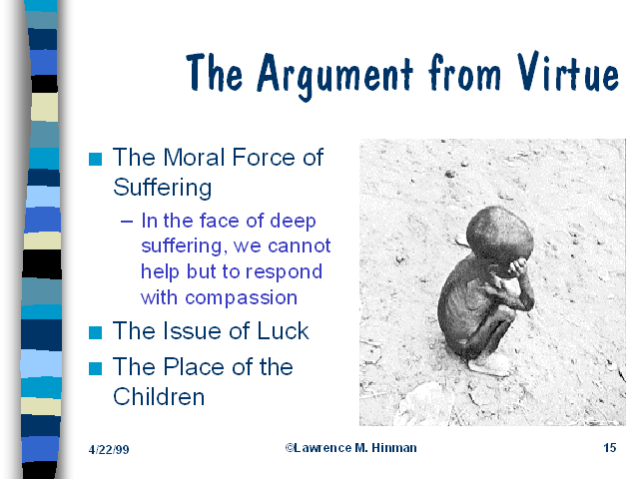
Koe Maumau he Ngahi Vā ‘oe Tangata
Fiekaia moe Tukuhausia

Slide 20
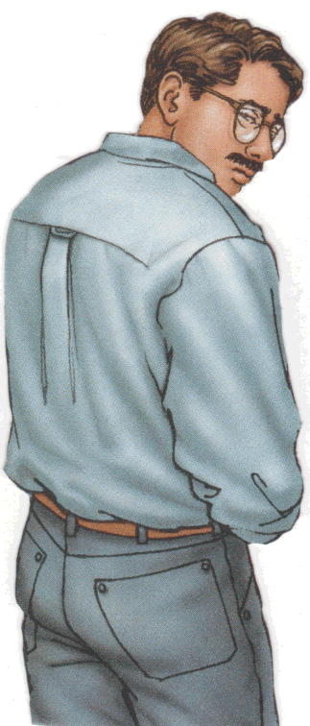
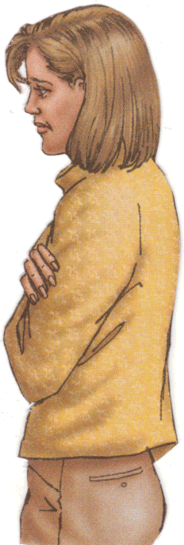
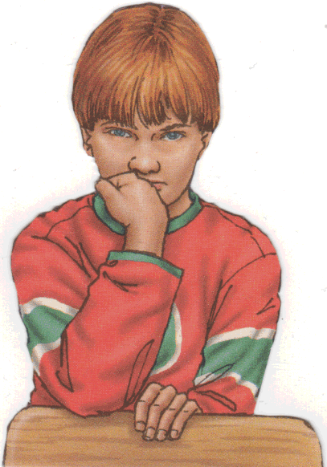
Koe Maumau he Ngahi Vā ‘oe Tangata
Motuhia Fāmili

Slide 21
Koe Maumau he Ngahi Vā ‘oe Tangata
’EITISI
Fe’auaki

Slide 22
Koe Maumau he Ngahi Vā ‘oe Tangata
Faito’o-Kona-Tapu moe Kavamalohi

Slide 23

Koe Maumau he Ngahi Vā ‘oe Tangata
‘Uli’i ‘oe ‘Atakai

Slide 24
Koe Maumau he Ngahi Vā ‘oe Tangata
Koe ikai 'Ilo
'ae Ngāhi Tefito'i Mo'oni

Slide 25
Koe Fiema'u 'oha
Ngahi Mahino Fo'ou
Ke Mahino kia kita ‘ae Totonu
Ke te Liliu Mo’oni
Ke Mo’onia ‘ete Fetu’utaki
moe Ni’ihi kehe
Pea Liliu ‘ae Sosaieti

Slide 26
Koe fiema’u ke toe
fakafotunga fo’ou ‘ae totonu
Tali kihe Ngahi Tefito Fehu’i ‘oe Mo’ui
‘Oku mo’ui ‘ae ‘Otua
Taumu’a ‘oe Mo’ui
Koe Tupu’anga ‘oe Kovi
Koe Taumu’a ‘oe Hisitolia
Koe Mo’ui Hili ‘ae Mate

Slide 27
Koe fiema’u ke toe
fakafotunga fo’ou ‘ae totonu
Tali kihe Ngahi Tefito Fehu’i ‘oe Mo’ui
Fakafehoanaki lelei e Lotu moe Ngahi Filosofia
Fakamahino e Folofola
Fakalelei’i e
Ngahi fakakikihi ‘ihe
Ngahi Mo’oni Fakalaumālie
moe Fakamatelie

Slide 28
Koe fiema’u ke toe
fakafotunga fo’ou ‘ae totonu
Tali kihe Ngahi Tefito Fehu’i ‘oe Mo’ui
Fakafehoanaki lelei e Lotu moe Ngahi Filosofia
Ke Fakalelei’i ‘ae Fehoanaki ‘ae Lotu moe Saienisi
Faka’o’ofaki e Famili
Fakafeohi lelei e Ngahi Matakali, Ngahi Pule’anga, moe Ngahi Matakali Kehekehe

Slide 29
“Koe me’a ‘e taha ‘oku pau: koe tangata ‘e ‘ikai lava ‘o fakalaka kimu’a ‘aki ‘ae fa’u moe fa’u o ha ngahi lao moe tu’utu’uni… Koe ‘ilo ‘o ha ngahi me’a ‘oku ‘ikai tatau ia moe ‘ilo hono ‘uhinga,… koe ngahi lao ‘oku ‘ikai ke ‘ai ko ha ako’i ‘ulungaanga pe fakailifia…”
“Koe fē ha mamani maau ta’e ‘iai hano ‘ulungaanga totonu mo angama’onioni ke tofuhia ai katoa ‘ae fa’ahinga ‘oe tangata…?”
Hans Küng: German Sociologist
Global Responsibility: In Search
of a New World Ethic, 1991

Slide 30
Koe ngahi fakahinohino ‘a
Rev. Dr. Sun Myung Moon
Unification
Principle
Koe Tefito’i Mo’oni Fakafāitaha’i

Slide 31
Koe Tefito’i Mo’oni Fakafāitaha’i
Ngahi Maama Fo'ou
Natula ‘oe ‘Otua
Taumu’a ‘oe Mo’ui ni
Koe Mo’ui hili ‘ae Mate
Taumu’a moe Founga ‘oe Hisitolia

Slide 32
Koe Tefito’i Mo’oni Fakafāitaha’i
Ngahi Maama Fo'ou
Koe ngahi tāfu'ua
Natula ‘oe ‘Otua
Taumu’a ‘oe Mo’ui ni
'ae ngahi kuonga
Koe Mo’ui hili ‘ae Mate
Taumu’a moe Founga ‘oe Hisitolia

Slide 33
Koe Tefito’i Mo’oni Fakafāitaha’i
Ngahi Maama Fo'ou
Tali 'oe Ngahi Tefito'i
Palopalema 'oe 'Aho ni
Natula ‘oe ‘Otua
Taumu’a ‘oe Mo’ui ni
Koe Mo’ui hili ‘ae Mate
Taumu’a moe Founga ‘oe Hisitolia

Slide 34
Koe Tefito’i Mo’oni Fakafāitaha’i
1. Koe Tefito’i mo’oni ‘oe Fakatupu
Ko ha Taufatunga Leleitaha
2. Koe Tupu’anga ‘oe Mo’ui Faingata’a’ia moe feke’ike’i
Koe tupunga ‘oe Kovi
3. Koe Tefito’i mo’oni ‘oe Fakafo’ou
Koe toe fakafo’ou ‘oe Taufatunga Leleitaha

Slide 35

Family Federation for
World Peace and Unification
Koe Kautaha Fakatahataha'i
'oe Fāmili Ke Ma'uma'uluta
mo Melino 'ae Mamani

Slide 38
Kapau fiema’u ha fakamatala
vakai ki he website
www.unificationstudy.com
E-mail
sacfamfed@aol.com

Slide 39
Slideshow Presentation by
Eleonore de Watteville

Slide 40
Liliu Lea
‘Aiona F. Teu
Founder of the Tongan Society
of America
President of the Pacific Islanders
Association

